Slide 1
DEVELOPMENTAL SCREENING: Administration, Scoring, and Interpretation
Notes:
This training is designed for the people who will help administer the screening measures (e.g. give the measures to parents, help them complete the measure); and score the measures. In some clinics, these roles will be completed by front desk staff and/or medical assistants. In other clinics, medical providers (e.g. physicians; nurses) may fill these roles.

Slide 2
The Perez Family: Miguel
Miguel is a 9-month-old Latino boy.
Miguel’s mother came to the well-child visit and completed the ASQ-3 and ASQ:SE-2 questionnaires.
Miguel’s mother expressed concerns because Miguel cries “all the time” and it is hard for her to keep him on a consistent feeding and eating schedule.
Miguel’s mother was anxious to hear the results of the screening…
TO BE CONTINUED . . .
Notes:
*

Slide 3
It Takes a Whole Team!
Notes:
A successful developmental screening initiative is a team effort. It’s important for everyone to know and play their part. As we go through the workflow for our clinic, notice the important role(s) that you will be asked to fill. Each part of the workflow needs to go smoothly so that no children fall through the cracks.

Slide 4
Workflow: Roles of Care Team Members
Care coordinator identifies in the EMR which children have well-child visits scheduled and selects correct screening measures for child’s age and language of parent.
Day of visit: Registration staff collects screening measure; if not completed/failed to bring in, gives blank screening to parent to complete in the waiting area.
Care coordinator mails screening and letter explaining screening to parent two weeks prior to visit and asks parents to hand in date of visit.
MA collects screening measures from parent; if not done, helps parent to finish in exam room.
Parent completes screening measures at home before
Well-child visit.
MA scores screening measures and puts in folder for provider along with Milestones Moments booklet.
Notes:
This slide and the next one show the possible workflow and work roles for a clinic; these can be modified to fit those of your clinic. The idea is to provide some guidance to the audience about who will be responsible for what part of the screening process. Highlight the roles that fit the audience you are speaking to.

Slide 5
Provider initiates developmental conversation with parents and discusses screening results.
If a referral is recommended, provider discusses recommendation with parents and provides guidance re: process.
If a referral is recommended, MA assists with completing referral forms and provides family written referral info.
Provider documents screening results and follow-up plan in EMR
Front desk staff scans screening results and uploads in EMR.
If a referral made, within one week, care coordinator assists family with linkage to referrals
Notes:
This is a continuation of the previous slide, showing the rest of the workflow.

Slide 6
Tips for Successful Screening
Explain to the parents the screening process:
Purpose
Importance
Next steps
Determine whether a parent needs additional help with the questionnaires.
If a parent declines to complete measure, provide this information to provider.
Notes:
Often, a front desk staff person or a medical assistant will be the one asking the parent to complete the screening measure(s). It is important for them to convey to the parent that:
If their child is in a certain age range, the parent will be asked to complete these screening measures.
The measures will help the doctor to understand how their child is developing.
The measures covers a range of ages, so their child might not have acquired all of the skills described yet.
If a parent doesn’t know the answer to a question, they can try out the skill in the waiting room, make a best guess, and talk to the child’s doctor about that item.
The child’s doctor will go over the questionnaire with the parent during the appointment and will answer any questions that the parent has about their child’s development.
*

Slide 7
Documents Needed after Screening
Completed summary page showing scores of screening measures
Milestones Moments booklet
Referral forms:
Early intervention program
School IEP
Mental health program
Plan for inputting information in chart
Notes:
Customize this slide to fit your clinic procedures. This example includes the documents used by the First Connection clinics. In these clinics, the Medical Assistant prepared the listed documents for the medical provider, so that they would have them ready to review with the parent.

Slide 8
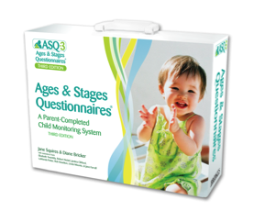
SCREENING TRAINING: Ages and Stages Questionnaire-3® (ASQ-3)
Notes:
If you plan to train in use of the ASQ-3, your clinic would need to purchase the materials for the measure. The materials are copyrighted, but if you purchase a site license, for example, you can print out measures as needed. Therefore, you can use those measures for training staff.
*

Slide 9
ASQ-3: Overview
Standardized screening measure
Available in English, Spanish and other languages
Completed by parent/caregiver in 10-15 min
For children ages 2 to 60 months (different forms for different ages)
Accurately identifies children at risk for developmental delays
Encourages parent involvement
Parents learn about development while completing measure
Notes:
*

Slide 10
ASQ-3: Domains
Communication: language skills
Gross Motor: coordination of arms and legs
Fine Motor: coordination of hands and fingers
Problem Solving: problem-solving skills and how to play with toys
Personal-Social: self-help skills and interactions with others

Slide 11
ASQ-3: Age Administration Chart
The first step is to select the correct ASQ-3 for the child’s age
Notes:
This slide assumes a clinic is using the paper/printed version of the ASQ-3. If using the online version, the program will select the correct measure for the child’s age.
If using the paper/printed version, we recommend that you print a handout for participants with the “Age Administration Chart.” You may also put a screenshot of that table on this slide; it is copyrighted, so we did not include it here. This will show the correct measure to use for each age group. You can then highlight the ages that you will be using for your screening initiative. For example, if you plan to use the ASQ-3 at ages 9, 18, and 24 months (per AAP recommendation), then you will need to decide if a child comes in at 8 months or 10 months, which measure should you select.
*

Slide 12
Online Age Calculator
http://agesandstages.com/age-calculator/
*
Notes:
There is an on-line calculator that allows you to quickly calculate the child’s age and which measure to select. We recommend going to the website and showing the participants how to use it, by entering an administration date, child’s date of birth, and if applicable, number of weeks premature.
*

Slide 13
ASQ-3: Adjustment for Prematurity
Children considered premature: were born before 37 weeks of gestational age.
Adjust the age for prematurity for children younger than 24 months of age.
Example: Alexandra is 18-months and 2 days old. According to the age chart, she would get the 18 month ASQ-3. However, she was born 6 weeks premature. So instead of giving the 18 month ASQ-3, she will get the 16 month ASQ.
Notes:
*

Slide 14
ASQ-3: Administration
Explain to the parent how to complete the questionnaire
Parent will answer each question using: “yes”, “sometimes” or “not yet.”
Ask the parent to check “yes” or “no” for each question in the “Overall” section. If they check “yes” they should write an explanation.
Provide parent with assistance and independence
Notes:
Provide a handout to the audience that is a sample of the ASQ-3 measure. Choose a measure that matches one of the ages you’ll be using for well-child visits.
The ASQ-3 was written at a low reading level* so it can be completed independently by most parents or caregivers.
It is helpful to have someone available who can answer questions if the parent has difficulty understanding a question.
The clinic can also purchase an ASQ-3 “toolkit” which is a bag of toys that a parent can use in the waiting room. These toys can be used by a parent to see if their child is able to perform a specific skill.
*

Slide 15
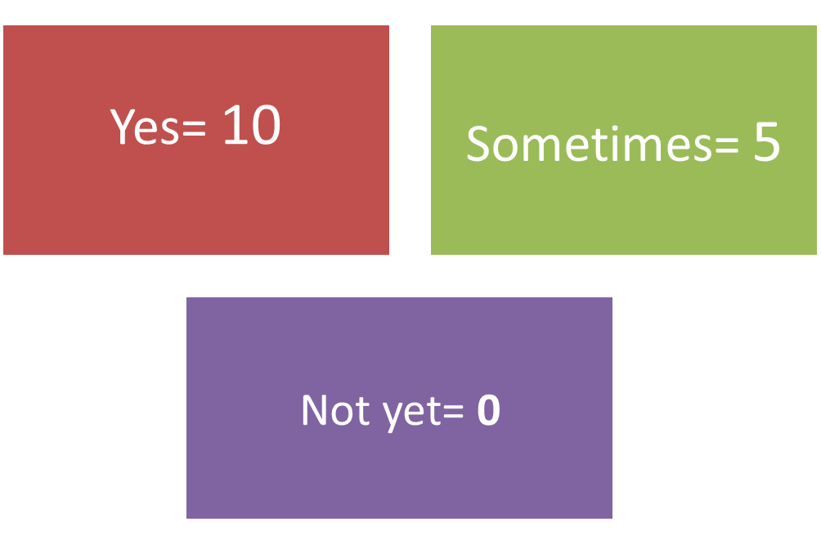
ASQ-3: Scoring
Score each section of the questionnaire:
Notes:
In some clinics, the ASQ-3 will be scored by a medical assistant; in others, the physician will score the measure. It takes about two minutes to score after a person becomes familiar with the scoring.
Use the sample questionnaire to show how scoring is done. For each item, write a number in the blank space to the right of the question. The numbers are shown above.

Slide 16
Sample Scoring
Notes:
To practice, insert a screenshot of a completed section of an ASQ-3 on this blank slide.
Ask the audience to indicate what score to put in the blank space for each item.

Slide 17
ASQ-3: Scoring Steps
Write the score from each item in the blank to the right of each question.
Total the number of points and write in the total number for that specific domain
Communication Total ___, Gross Motor Total___ etc.
In Section 1 of “ASQ-3 Information Summary” page
Transfer the Total score for each domain in the Total Score column.
Notes:
Direct the audience to look at the Information Summary page, which is the last page in their sample ASQ-3.

Slide 18
ASQ-3: Scoring Steps (cont’d)s
Fill in the circles with the corresponding score for each domain.
Transfer the Overall responses onto Section 2 of the scoring sheet by
circling “yes” or “no” depending on the parent’s response to each question.

Slide 19
Practice Scoring
Notes:
Provide a sample of an ASQ-3 that has the answers filled in (as if a parent completed it).
Fill in the correct score for the items in the first domain, the Total for that domain, and the bubbled number in the Information Summary for that domain, as an example.
Then, have the participants fill in the scores for the other domains, and the totals for each domain.
Have people check their answers by providing them with the correct Total Scores for each domain. After they confirm they have the correct scores (and answer any questions for people who came up with a different score), have them fill in the bubbles on the Information Summary page.
You can also provide a completed Information Summary page for your example, so that they have the correct version to compare their answers to.

Slide 20
ASQ-3: Omitted Items
Try to obtain answers from parent; encourage them to make their “best guess.”
2 items maximum can be omitted
Steps to take when 1-2 items are omitted:
Calculate the average score for the answered questions in that domain (divide the total score by the number of questions answered in that domain).
Add that number (the average score) to the total score to get a new Total Score for that domain.
Notes:
One complication occurs when a parent omits one or more items when they are completing the questionnaire.
If more than 2 items are omitted, then the questionnaire cannot be accurately scored. If there are 1 or 2 items missing and the parent cannot choose an answer, then follow the procedure for “omitted items.”
We’ll show an example on the next slide and you’ll get a chance to practice.
*

Slide 21
ASQ-3 Omitted items example
1. Divide total domain score by the number of items answered in that domain.
Example: The domain has 6 items, and the parent only answered 5 of them. The total score for the 5 items that were answered is 45.
45 (area score) ÷ 5 (items) = 9 points.
2. Add this average item score to the total domain score to get a new total score.
45 + 9 points = new total of 54 points
Notes:
This method helps us to make the “best guess” about what the score would have been if the parent had filled it in. The best guess is based upon the other scores in that area.
For example, if five items were scored with “5,” what would the best guess be for the 6th item? (answer: 5). Show how 5*5/5 =5.
Repeat with five items answered with “10.” The best guess for the 6th item would be 10. Show how 10*5/5 = 10.
Participants should know that the need to omit items does not happen very often. Items should only be omitted if they are very inappropriate to try with a child.
For example, the mirror items may be inappropriate because of cultural and spiritual beliefs of some families. It would be inappropriate then to try this item with a child.
However, if the only reason an item is omitted is lack of opportunity, the child should be given the opportunity to practice and try the item.

Slide 22
Practice Omitted Items
Notes:
We recommend that you copy a section of the ASQ-3, where all but one answer is completed.
Have participants try figuring out what the Total score should be, using the omitted items calculation.
Show them the correct response and answer any questions for people that had difficulty getting the correct answer.
Show on the Information Summary page how, if you did not give “credit” for that omitted item, a child’s score could appear very low in that domain. Giving credit for the omitted item by using the “best guess” of what it would have been will help increase the accuracy of the score.

Slide 23
ASQ-3: Interpretation
Black area: Problem
Gray area: : May have a problem
White area: No Problem
*Parent concerns may also justify a problem
White
Notes:
The Information Summary shows three levels of concern (outlined above).
In addition to looking at the scores, the provider will discuss any concerns that the parent brings up, or any concerns noted in Section 2 of the Information Summary page.
The medical providers will review the results with the family and making recommendations and referrals if there is an area of concern.
Note: We don’t recommend using words like “pass” and “fail” when reviewing screening results.
*

Slide 24
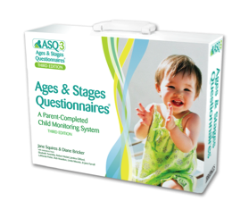
Ages and Stages Questionnaire:
Social-Emotional (ASQ:SE-2)®

Slide 25
What is the ASQ:SE-2
Parent-completed questionnaire
Identifies young children at risk for social or emotional difficulties.
Research shows that if only the ASQ-3 is administered, many children who have social-emotional needs will be missed
Notes:
When the same children were given both the ASQ-3 and the ASQ:SE-2, many children had concerns noted on the ASQ:SE-2 but their ASQ-3 did not show any areas of concern. Therefore, it is important to specifically screen for social-emotional needs.
Williams, M. E., Zamora, I., Akinsilo, O., Hickey Chen, A., & Poulsen, M. K. (2018). Broad developomental screening misses young children with social-emotional needs. Clinical Pediatrics, 57, 844-849.

Slide 26
ASQ:SE-2 Domains
Self-Regulation: Does your child settle herself down after exciting activities?
Compliance: Does your child do what you ask him to do?
Communication: Does your child look at you when you talk to her?
Adaptive Functioning: Does your child stay away from dangerous things, such as fire and moving cars?
Autonomy: Does your child cling to you more than you expect?
Affect (mood): Does your child seem happy?
Interactions with People: Does your child try to hurt other children, adults, or animals (for example, by kicking or biting)?
Notes:
There is only one total score for the ASQ:SE-2 (unlike the ASQ-3, which has separate scores for the different domains). This slide shows the various areas that are covered in the ASQ:SE questions. All questions are included in one total score.

Slide 27
ASQ:SE-2 Scoring
Response to each item can be:
“Often or always”
“Somewhat”
“Rarely or Never”
In addition, parents are asked to check items that they are concerned about.
:

Slide 28
ASQ:SE-2 Scoring
Each question response has a small letter next to it, which indicates what numerical score to give that response.:
z = 0 points
v = 5 points
x = 10 points
If the parent checked “concern” = 5 additional points
Write the correct number of points in the blank to the right of the question for each item.
Notes:
Note the placement of the responses receiving 0, 5, or 10 points varies depending on the question. For some questions, the first answer choice gets a score of “0,” and for others, the right-hand answer choice gets a score of “0.” Be sure to look at the small letters to determine what score to five.

Slide 29
Practice Scoring ASQ:SE-2
Notes:
We recommend putting a screen shot of a section of the ASQ:SE-2, showing a few sample answers, with responses filled in.
Emphasize that sometimes the “z” is the left-hand answer, and other times the “z” is the right-hand answer.
Go through the correct score for each item on the screen. (We did not include the screenshot here because it is copyrighted, but if you purchased a site copy of the measure you can provide it to your audience.)

Slide 30
ASQ:SE-2 Summary Sheet
Transfer “Total Points” on each page to summary sheet.
Add up all “Total Points” in section 1 for the “Total Score”
Transfer “Total Score” to the box next to the cutoff score.
If the “Total Score” is higher than the cutoff, then there is a concern and referral should be made.
Section 3: circle “yes” or “no” for each question.

Slide 31
ASQ:SE-2 Summary Sheet Sample
Notes:
We recommend putting a screen shot of an ASQ:SE-2 summary sheet, showing a score that is over the cutoff. Note that for the ASQ:SE-2, a higher score means a problem. In contrast, for the ASQ-3, a lower score means a problem.

Slide 32
ASQ:SE-2: Scoring Omitted Items
Check for missing items and ask parents to try to answer.
If 1 or 2 items missing: go ahead and score the usual way.
If 3 or more items missing: determine if the total score within 5 points of the cutoff?
If no, do not adjust score.
If yes, you need to adjust the score (see next slide).

Slide 33
ASQ:SE-3: Adjusting the Score
Divide the Total Score by the number of items parents answered. That gives you the average score per item.
Use that average score for each missing item
Example:
Parent omitted 3 items (answered 30 out of 33 questions)
Total score = 80 80 divided by 30 = 2.66
Add 2.66 to each unanswered question.
3 missing items x 2.66 points = 7.98 (Can round up to 8)
Add to total score: 80 + 8 = 88
Notes:
The process for adjusting for omitted items is similar to what was done on the ASQ-3.

Slide 34
Miguel’s Results…
Please score the ASQ-3 and ASQ:SE-2 screening measures and determine if there are any areas of concern based on the results.
Please debrief with your partner and as a group.
Notes:
In our trainings, we create a sample of an ASQ-3 and an ASQ:SE-2 for the child, Miguel, age 10 months, who was introduced in the first slide.
Fill in the items as if the parent completed them, and then the audience scores each item and completes the Summary pages for each measure. This is helpful as extra practice.
Some groups enjoy timing to see how quickly they can score the ASQ. This helps illustrate that it is not a time-consuming activity.
*

Slide 35
ASQ: Frequently Asked Questions
Q: Isn’t the medical provider’s impression of the child’s development more accurate than that of the parents’?
A: The ASQ is designed to be completed by a parent or caregiver who knows the child well. This information is then combined with the provider’s expertise to determine the best approach to any concerns that come up.
Q: What if the provider does not see the problems that the parent is reporting on the questionnaire?
A: Defer to the parent or caregiver, because they have the opportunity to observe the child in many different settings.
Q: Can the ASQ be completed by a babysitter or other family member?
A: The ASQ:SE can be completed by anyone who has 20 or more contact hours per week with a child.
Q: I’ve noticed when the ASQ:SE-2 is completed by two different caregivers, the scores come out different. How do we know which one is right?
A: Scores may differ since a child's behavior will often be different in different settings and with different caregivers. There are no right and wrong answers.

Slide 36
M-CHAT-R: Modified Checklist for Autism in Toddlers (Revised)
[add picture of a toddler]

Slide 37
Disparities in Screening for ASD?
Referral, diagnosis, and treatment may be late or reduced for:
Ethnic minority children, particularly Latinx and Black children
Children with less severe symptoms and delays
Screening is less consistent
and later for children who
are ethnic minorities
or low socio-economic status (SES)
Consistent screening helps reduce disparities and ensure children get connected with early intervention.

Slide 38
M-CHAT-R: Overview
Parent report
Standardized questionnaire
Validated for ages 16-30 months
20 items: yes/no questions
Translated into multiple languages, used in many countries
Available for free at www.mchatscreen.com
Notes:
The paper that provided validation for the tool is: Robins, D. L., Casagrande, K., Barton, M., Chen, C. A., Dumont-Mathieu, T., & Fein, D. (2013). Validation of the Modified Checklist for Autism in Todders, Revised with Follow-up (M-CHAT-R/F). Pediatrics, peds.2013-1813; DOI: https://doi.org/10.1542/peds.2013-1813.

Slide 39
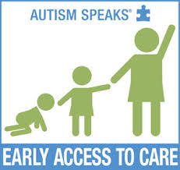
M-CHAT-R: Overview
MCHAT-R Items as Predictors of ASD
Best discriminators of ASD:
Pointing to show interest
Responds to name
Interest in other children
Bring to show
Follows point
Imitation
Reciprocal smile
Notes:
[asked Eliza & Irina for citation]

Slide 40
M-CHAT-R: Scoring
If you point at something across the room, does your child look at it? (FOR EXAMPLE, if you point at a toy or an animal, does your child look at the toy or animal?)
Yes (0) No (1)
3. Does your child play pretend or make-believe? (FOR EXAMPLE, pretend to drink from an empty cup, pretend to talk on a phone, or pretend to feed a doll or stuffed animal?)
Yes (0) No (1)
Notes:
Pass out sample of the questionnaire.
For each item (except the three on the next slide), an answer of “no” is scored with 1 point.

Slide 41
Reverse Scoring For items 2, 5, and 12 “YES” indicates ASD risk
2. Have you ever wondered if your child might be deaf?
YES (1) NO (0)
5. Does your child make unusual finger movements near his or her eyes? (FOR EXAMPLE, does your child wiggle his or her fingers close to his or her eyes?)
YES (1) NO (0)
12. Does your child get upset by everyday noises? (FOR EXAMPLE, does your child scream or cry in response to noise such as a vacuum cleaner or loud music?)
YES (1) NO (0)
Remember except for the reverse scoring questions:
Yes (0) No (1)

Slide 42
M-CHAT-R Interpretation and Follow-up Recommendations
HIGH- RISK: Total Score is 8-20 (Problem)
Refer for diagnostic evaluation and eligibility evaluation for early intervention.
MEDIUM- RISK: Total Score is 3-7 (Possible problem)
Administer the Follow-up (second stage of M-CHAT-R/F) to get additional information about at-risk responses.
LOW- RISK: Total Score is 0-2 (No problem)
If child is younger than 24 months, screen again after second birthday.

Slide 43
M-CHAT-R Follow-up Questions
If Total Score is 3-7, the provider should use the guide for follow-up questions to get more information, to decide if the child is high-risk and if they should be referred for additional evaluation.
Notes:
If training medical providers, pass out the follow-up interview guide for the M-CHAT-R, and have the providers practice going through the decision tree.
If training is for medical assistants who will just be scoring but not interpreting or making referrals, then they would provide the Total Score to the provider who would determine whether or not to do a follow-up interview.

Slide 44
M-CHAT-R Case Exercise
Please score the sample M-CHAT-R and review the results as a group
Notes:
Complete a sample M-CHAT-R. Be sure to score a “fail” response for one of the reverse items, so the audience will have practice catching the reverse scored items.
Have each participant score the measure and then share the correct score.
Discuss any questions to ensure everyone understands how to score.

Slide 45
THANK YOU!

