Slide 1
DEVELOPMENTAL SCREENING: Linkages to Resources
Notes:
Notes for Presenter
This training is designed for the people who will be helping to link families with resources, especially when a developmental delay has been identified. Depending on the agency, this step may be handled by the pediatric medical provider, or there may be a case manager, care coordinator, referral coordinator, or other professional who helps to link families.
The resources described in the training are focused on those available in California. When possible, information is also provided regarding the federal programs that should be present in any state. Some of the slides will need to be tailored to the state where the training is being held, and the local resources available. In addition, resources can be added that are specific to the health plans or internal clinic resources available at each site.
It is important that this training is delivered by someone who is knowledgeable about the service system and available in-house resources.
The toolkit [give link re where to find it] provides additional details re: the services described in this PowerPoint and tips for navigating the service system.
Approximate presentation time: 45-60 minutes

Slide 2
Next Steps After Developmental Screening
All parents need developmental guidance:
What to expect next in their child’s development
How they can support their child’s development
Some parents will need more:
Referral for a thorough evaluation
Resources for help in different areas of development
Family supports
Notes:
Additional Talking Points
The developmental screening tool is helpful in facilitating a developmental conversation with the parent/caregiver. Even when the screening indicates typical development in all areas, parents appreciate the opportunity to talk with their child’s provider about their child’s development. When a delay is identified or there seem to be risk factors, the conversation can lead to a referral or resource.

Slide 3
Developmental Guidance
Learn the Signs: Act Early
Give all parents the Milestones Moments booklet.
Review with them the appropriate page for their child’s age:
Discuss the milestones that their child has reached.
Discuss the ideas for activities they can do at home.
Encourage them to look ahead at the milestones coming up next for their child.
If the parent has a cellphone, encourage them to download the Milestones Tracker app. This is an app version of the Milestones Moments booklet.
Vroom
Vroom can be downloaded as an app and provides science-based video examples of ways to connect with your child and support their development.
Notes:
Notes for Presenter
The individual who handles this step varies depending on the child’s age.
This slide contains examples of resources that are helpful to all parents of young children. It can be modified to fit the resources that your agency is using.
The Centers for Disease Control and Prevention (CDC) Learn the Signs: Act Early campaign includes many resources for parents and professionals. https://www.cdc.gov/ncbddd/actearly/index.html.
The Milestones Moments Booklet can be ordered free in English and Spanish. The CDC will also give permission if you want to modify the materials to add your agency logo.
The Milestones Tracker app can be downloaded onto the parent’s cellphone.
Vroom.org has an app as well as videos on their website.
Your agency can play the videos in the waiting room while parents are waiting for their appointment.
Videos can also be shown directly to a parent on an iPad or other tablet if the appointment is home-based.

Slide 4
Screening and Referral Algorithm
When delays are identified on the screening tool, the algorithms on the next pages provide guidance about where to make referrals.

Slide 5
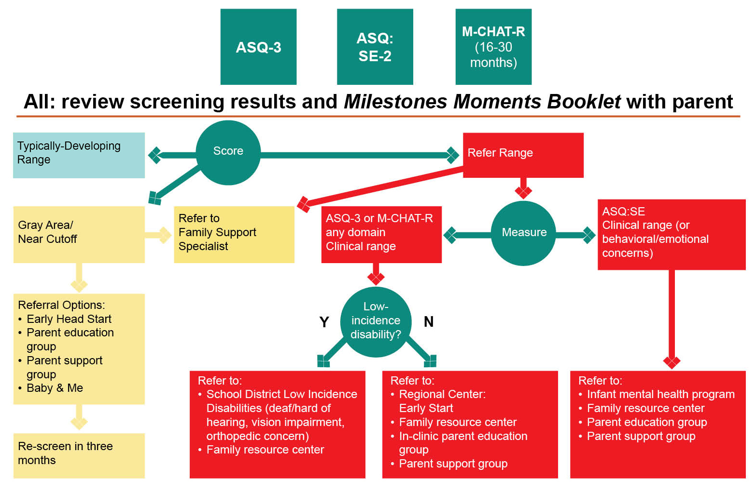
Screening and Referral Algorithm: Birth through 2 Years Screen as part of assessment intake and every 6 months
EARLY SCREENING, BETTER OUTCOMES:
Developmental Screening, Referral and Outreach Toolkit for Family Resource Centers
Notes:
Notes for Presenter
This is an example of a referral algorithm that includes resources available in California. It can be modified to fit the service system in your area.
If you use a process like this, it is recommended that you provide training participants with a full-page color copy that they can follow along with during this training.
Vignettes will be presented where participants can use the algorithm to help decide where the child could be referred.

Slide 6
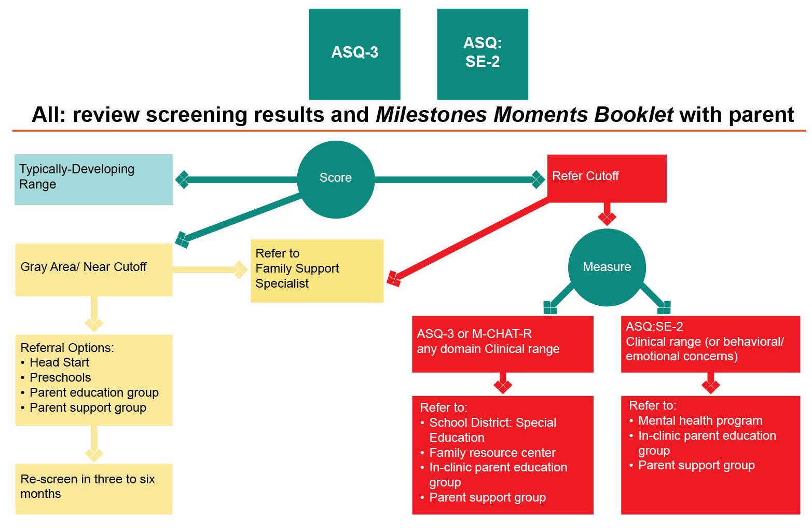
Screening and Referral Algorithm: 3 through 5 Years Screen as part of assessment intake & every 6 months
7/5/2022
EARLY SCREENING, BETTER OUTCOMES:
Developmental Screening, Referral and Outreach Toolkit for Family Resource Centers
Notes:
Notes for Presenter
Two screening and referral algorithms are provided, based on the age of the child. Generally, children younger than age 3 with delays are referred to Early Intervention (Part C) programs, whereas children ages 3-5 with delays are referred to school special education programs.

Slide 7
Early Intervention Services
Early Intervention services are for children birth up to age 3.
In California, the early intervention program is called “Early Start.”
Eligibility in California:
Developmental delay in one or more domains (cognitive, communication, social-emotional, adaptive, physical/motor)
Established risk condition that is likely to lead to delayed development
High risk due to combination of risk factors (e.g., low birthweight, prematurity, low Apgar scores, prenatal substance exposure, accident or illness)
Services are based on an Individualized Family Service Plan and may include:
Speech therapy
Occupational therapy
Physical therapy
Child development
Services are usually provided in the home, but sometimes center-based programs are also available
Notes:
Additional Talking Points
All states have an early intervention program for children birth to age 3 (sometimes referred to as “Part C” or “IDEA Part C” because it is part of the Individuals with Disabilities Education Act or IDEA).
You can find your state’s early intervention program at the Early Childhood Technical Assistance Center website: https://ectacenter.org/contact/ptccoord.asp.
You can add the name of the early intervention program in your state to the slide.
Most states have similar eligibility criteria, but they can vary depending on funding, so check with your state’s early intervention program for the most current eligibility criteria.

Slide 8
Understanding Regional Center Eligibility
Before age 3: Early Start
Developmental delay, but no diagnosis needed
Children at high risk for developmental delay may also be eligible
After age 3:
Must have diagnosis of autism, intellectual disability, cerebral palsy, or epilepsy and functional impairment.
Alternative: must meet criteria for “fifth category”—conditions requiring services similar to those with intellectual disability.
Notes:
Additional Talking Points
Regional centers are the developmental disability providers in California. They administer the IDEA Part C (Early Intervention for Infants and Toddlers, called Early Start in California) program for children under age 3. They also administer services for children age 3 and older and for adults with diagnosed developmental disabilities.
Most states have an early intervention system similar to what is described here. The service system for people with developmental disabilities older than age 3 is more variable across states.
The National Association of Councils on Disabilities has a link to the Developmental Disability Council in each state: https://nacdd.org/councils/. This is a good place to start in learning about the resources available in your state for individuals with developmental disabilities.

Slide 9
Special Education
Children ages 3 and older who have developmental delays should be referred to Special Education for an evaluation.
If an eligible condition is identified, the school will work with the parent to develop an Individualized Education Plan (IEP).
Parents should request the evaluation in writing.
Some school districts have a special evaluation unit for preschool-age children.
If a child is already enrolled in early intervention, they will assist with transition to preschool.
Notes:
Notes for Presenter
For families in the Los Angeles Unified School District, parents can call the Preschool Assessment Team at 213-241-4713 to request an evaluation for special education.

Slide 10
Behavioral Health Services
Infant and early childhood mental health services for children birth through age 5 are effective for young children who:
Experience traumatic events
Show dysregulation such as excessive crying, sleeping, or eating
Experience challenges in attachment relationships
Exhibit behavioral challenges or aggression
Encounter difficulties forming relationships with peers
Experience difficulties separating from parent for school or daycare
Experience difficulties with learning, school behaviors, attention to tasks
Mental health services for young children always include the parents/caregivers in the interventions
Notes:
Additional Talking Points
Examples of times when infant and early childhood mental health services are helpful:
Experiencing traumatic events such as parental separation, exposure to domestic or community violence, difficult medical procedures or illness
Showing dysregulation such as difficulties with crying, sleeping, eating
Challenges in attachment between parent/caregiver and child
Behavioral challenges such as hitting, running away from parent, refusing to follow adult directions
Difficulties forming relationships with peers
Difficulty separating from parent for school or daycare
Difficulties with learning, school behaviors, attention to tasks

Slide 11
Behavioral Health Services Through Health Insurance
The Affordable Care Act mandates coverage for behavioral health services.
All state Medicaid programs provide some mental health services.
Most states now have laws that require insurance coverage of autism behavioral services.
Families and providers can start by calling the Managed Care Health Plan to request mental health services or behavioral intervention for autism.
Notes:
Additional Talking Points
As of 2014, most individual and small group health insurance plans are required to cover mental health services. Medicaid also must cover mental health services.
Parity requirements: coverage for mental health cannot be more restrictive than coverage for medical services.
More information about the Affordable Care Act and mental health coverage can be found here: https://www.mentalhealth.gov/get-help/health-insurance
More information about autism insurance coverage is available here: http://www.ncsl.org/research/health/autism-and-insurance-coverage-state-laws.aspx

Slide 12
Specialty Mental Health Programs
Early and Periodic Screening, Diagnostic, and Treatment benefit (EPSDT)
Federal benefit for children under 21 with Medicaid
Includes mental health services for children when “medically necessary”
In California, specialty mental health services are funded through contracts with county mental health plans.
Many providers now specialize in infant and early childhood mental health.
Notes:
Notes for Presenter
One of the covered benefits under EPSDT is mental health services when medically necessary: https://www.medicaid.gov/medicaid/benefits/epsdt/index.html
In California, Medi-Cal specialty mental health services are “carved out” of the broader Medi-Cal program under a waiver. The plans are administered through County Mental Health Plans. https://www.dhcs.ca.gov/services/Pages/Medi-cal_SMHS.aspx

Slide 13
Practice Vignettes: Where do you refer?
Natalia is a 4-year-old girl. She scored in the refer range for Communication and Gross Motor on the ASQ-3. She has an existing diagnosis of cerebral palsy.
In addition, Natalia’s mother shared that Natalia was in a car accident with her approximately 3 months ago. Since the car accident, Natalia presents as especially sad, fearful and hypervigilant. She will not separate from her mother, cries frequently, and often experiences nightmares.
Natalia has not been able to ride in a car since the accident, and she tends to flinch when she hears a loud noise.
She scored over the cutoff for the ASQ:SE-2.
Notes:
Notes for Presenter
This slide provides a longer case vignette which can be used to help people practice using the referral algorithm to determine where to refer children.
The following slides offer briefer case vignettes. You can use more or less of these vignettes depending on how much time you have.
Alternatively, you can offer a follow-up training where you focus on discussion of the vignettes, as well as examples of referral challenges that staff members bring for discussion/consultation.
Based on the referral algorithm for California:
Natalia: refer to school district for IEP evaluation and regional center; also refer to infant/early childhood mental health program

Slide 14
Practice Vignettes: Where do you refer?
Brandon, 18 months old, scored in the refer range for Communication on the ASQ-3.
Carla, 3 months old, scored in the refer range for Gross Motor on the ASQ-3.
Jason, 16 months old, scored in the refer range for Personal-Social on the ASQ-3, and over the cutoff for the ASQ:SE-2.
Notes:
Notes for Presenter
Based on the referral algorithm for California:
Brandon: Refer to regional center for early intervention; may also refer for speech therapy through insurance.
Carla: Refer to regional center for early intervention; may also refer for physical therapy through insurance.
Jason: Refer to both regional center and infant mental health program.

Slide 15
Practice Vignettes: Where do you refer?
Juanita, 6 months old, scored in the gray area/near cutoff range for Gross Motor, Fine Motor, and Problem-Solving on the ASQ-3.
David, 8 months old, scored in the typically-developing range on the ASQ-3, close to the cutoff on the ASQ:SE-2; his mother is tearful.
Raymond, 4 years old, scored in the refer range for Communication on the ASQ-3, and over the cutoff for the ASQ:SE-2.
Notes:
Notes for Presenter
Based on the referral algorithm for California:
Juanita: Refer to regional center for early intervention.
David: Refer to infant mental health services, Early Head Start, or other home visiting program.
Raymond: Refer to school district for IEP evaluation; also refer to infant/early childhood mental health program.

Slide 16
Practice Vignettes: Where do you refer?
Jaylinn, 24 months old, scored in the gray area/near cutoff range for Communication on the ASQ-3.
Deondre, 3 ½ years old, scored in the refer range on the ASQ-3 in all domains, and over the cutoff on the ASQ:SE-2.
Ricardo, 9 months old, scored in the refer range for Communication and Problem-Solving on the ASQ-3, and he has a severe vision impairment.
Notes:
Notes for Presenter
Based on the referral algorithm for California:
Jaylinn: Options might include providing developmental guidance and activities to try, and then scheduling a follow-up visit to screen again; might also refer to Early Head Start or a Baby and Me group for more developmental stimulation; may also refer to family resource center.
Deondre: Refer to school district for IEP evaluation; refer to infant/early childhood mental health program.
Ricardo: Refer to school district for IEP evaluation; his vision impairment is a low-incidence-disability, which in California is handled by the school district instead of the regional center.

Slide 17
Practice Vignettes: Where do you Refer?
Hailey, 4 years old, scored in the typically-developing range in all areas; her mother would like her to start preschool.
Patricia, 2 years old, scored in the typically-developing range in all areas. But her mother tells you that Patricia cries all the time since her father got deported two months ago and the family is having financial problems.
Notes:
Notes for Presenter
Based on the referral algorithm for California:
Hailey: Refer to Head Start.
Patricia: Refer to mental health program, Early Head Start, or other local resource; can also refer to family resource center.

Slide 18
Tell Parents What to Expect Next: Referrals to Regional Centers
A regional center has 15 days to complete the initial intake appointment.
The regional center has 45 days to complete assessment for children birth to age 3, or 120 days for older children.
The regional center will call parent to set up initial intake.
It’s important for the parent to call to reschedule if they cannot make any appointments.
Tell the parent to call you if they do not hear from the intake person or if they have trouble with the process.
Tell parent you will follow up to check in on how the intake went.

Slide 19
Discussion: Regional Center Referrals
Which regional centers have you referred families to before?
What challenges have parents encountered?
What have you found helpful?
Notes:
Notes for Presenter
Depending on the length of your training, it can be helpful to add an opportunity for participants to discuss common challenges they have experienced and to get consultation from the trainer or from each other about handling these challenges. This can also bring up areas of concern that the agency can bring to the early intervention provider to request assistance.

Slide 20
Tell Parents What to Expect Next: Referrals to School Districts
A school district has 15 days to respond to a request for assessment (during the school year).
The school district will give parents an assessment plan.
Parents needs to sign the plan and return it.
The school then has 60 days to complete the assessment and hold an IEP meeting.
It is very important for a parent to attend the IEP meeting to hear what the district is recommending and what their options are.
If the parent is not comfortable signing the plan at the IEP meeting, they can ask to bring it home to discuss with their family members or others before signing.

Slide 21
Discussion: School Special Education Referrals
What school districts have you referred families to?
What referral processes have worked well?
What barriers have you encountered?

Slide 22
Warm Hand-Off
Referrals work better with a “warm hand-off.”
Help the parent make the phone call while you are with them.
Practice with them what they are going to say.
Be there to help if they get stuck.
Be there to talk about how the call went, and what they can do next.
Give them written information to take home to help complete the connection.
Ask if you can call back to see how the referral went.
Notes:
Additional Talking Points
These tips may be useful if you have a case manager or care coordinator who can directly assist parents with referrals.
Other agencies who may not be able to provide this level of support can remove this slide.

Slide 23
Written Information When Referring
Provide parent with the following:
Copy of the summary page of the ASQ-3 and ASQ:SE-2
Letter or form for parent to give the regional center or school, including information such as:
Date of screening
Address and phone number of the agency you are referring to
Reason for referral (reference the ASQ results)
Your name and phone number
Notes:
Notes for Presenter
Modify slide to include any written materials that you will be providing to parents.
It can be helpful to have a letter template tailored to your service system.

Slide 24
Follow-up Coordination
When making the referral, ask the parent to sign an authorization form permitting the release of information between your agency and the agency you are providing a referral to.
Then you can more easily follow up to get the results of the other agency’s evaluation.

Slide 25
After the Screening: Children Referred to Regional Center or Special Education
Contact family in two weeks to check status.
If the parent has not been in contact with the regional center or school, discuss barriers.
Is parent unsure about whether services are needed? Discuss your concerns again if necessary.
Has parent been waiting for a call? Encourage them to call again (with you if possible).
Has parent had difficulty getting through on phone to the regional center? Encourage parent to walk in and request intake.
Follow up again in two weeks.
Has parent started intake process?
Discuss their experience and address any questions.
Make sure they understand next steps and the timeline.
Help parent to access documents requested.
Request records from the agency and include in chart results of evaluation and services planned.

Slide 26
Need More Help?
Regional Center/Early Start: (800) 515-BABY (2229)
LAUSD Special Education:
Complaint Response Unit (LAUSD) (800) 933-8133
All:
Disability Rights California and the Office of Clients’ Rights Advocacy (www.disabilityrightsca.org)
Special Needs Network (www.snnla.org)
Learning Rights Law Center (www.learningrights.org)
Notes:
Notes for Presenter
These are resources in California where parents can get additional help if they want to appeal a decision or have a legal concern about their child’s access to services.
Note: This slide can be modified to fit the resources available in your community.
The Early Start BABY line is a number that parents can call if they have had difficulty accessing early intervention services in California.
The Complaint Response Unit is specific to LA Unified School District, but all school districts must provide a number where parents can file a complaint.
Disability Rights California is a legal advocacy organization funded by the California Department of Developmental Services; each state has a similar service as part of the Developmental Disability federal system of care.
The Special Needs Network is a parent-run organization based in Los Angeles that helps parents learn about their children’s rights and how to advocate.
The Learning Rights Law Center is a legal aid organization based in Los Angeles and focused on special education legal issues.
It is important to note that all states have free resources for appeals, parent advocacy, and legal advice; in most cases parents should not need to pay an attorney to help them address a concern with services for their child with special needs.

Slide 27
Family Resource Centers
Early Start family resource centers (FRCs) in California provide parent-to-parent support, outreach, information and referral services to families of children with disabilities and the professionals who serve them.
All 47 Early Start FRCs serve families of children birth to age 3.
Many have enhanced funding that allows them to serve families of children with developmental delays over the age of 3.
Find out more at http://www.frcnca.org.
Notes:
Additional Talking Points
Many parents find it very helpful to meet other parents who have children with special needs.
Family resource centers are funded by the California Department of Developmental Services to provide parent-to-parent support and linkage to resources.
FRCs are available in all geographic areas of California.
The website listed provides information about FRCs available by zip code.

Slide 28
Children of Color Parent Education, Support and Advocacy Organizations
Fiesta Educativa, Inc. http://fiestaeducativa.org/
Familias Unidas en Respuesta al Sindrome Down y otras Alteraciones (FUERZA, Inc.) http://www.fuerzainc.org/
Chinese Parents Association for the Disabled (CPAD) http://www.cpad.org/
Japanese Speaking Parents Association for Children with Challenges (JSPACC) http://www.jspacc.org/english.html
Notes:
Notes for Presenter
The remaining slides provide additional resources for parent support and education specific to Los Angeles County. It may be helpful to identify similar resources for parents in your community.

Slide 29
Disability-Specific Organizations
Autism Speaks http://www.autismspeaks.org/
Foothill Autism Alliance http://www.foothillautism.org/
Armenian Autism Outreach Project http://www.armenianautismoutreach.org/aboutus.php
Down Syndrome Association of Los Angeles http://www.dsala.org/
Fragile X Association of Southern California http://www.fraxsocal.org/

