Slide 1
DEVELOPMENTAL SCREENING: Developmental Conversations with Parents/Caregivers
Notes:
Notes for Presenter
This training is designed for Family Resource Center staff who will be discussing screening results with parents and caregivers. It includes information in multiple areas:
More information about the importance of standardized screening for different purposes
Tips for how to discuss screening results with parents
Particular attention to cultural competence, with a focus on talking with parents who are raising their child bilingually or using a language other than English at home
Vignettes to practice discussing screening results in more challenging situations
Approximate presentation time: 45 minutes; Depending on the audience and the time allotted, this training may be broken up into more than one session.

Slide 2
Developmental Conversations
Staff working at our agency develop close relationships with young children and their parents.
Developmental conversations between staff members and parents can:
  Support developmental progress.
  Enhance parent-child relationships.
  Provide linkage to needed resources.
  Strengthen connections between families and staff members.

Slide 3

How do you talk to families about their child’s development?
Notes:
Notes for Presenter
Lead brief discussion to share efforts and acknowledge that staff members are already talking to parents about development

Slide 4
What are the hardest parts of those conversations?
What, if anything, slows you down or prevents you from having those conversations?
Notes:
Notes for Presenter
Discuss barriers to discussing development.

Slide 5
Common Concerns
“What if I’m wrong?”
“What if the family gets angry with me?”
“I don’t know how they will react.”
“The family isn’t ready yet.”
“I don’t know where to refer them.”
“Referrals go to a ‘black hole.’”
Notes:
Notes for Presenter
Highlight concerns that were already identified.
Note additional ones that might not have come up but that we have heard from other staff members.

Slide 6
What are the benefits of conducting standardized developmental screening and discussing results with parents?
Notes:
Notes for Presenter
Elicit positive perspectives of staff members.

Slide 7
Standardized Screening Facilitates Developmental Conversations
All families benefit …
For children with typical development, screening …
Helps parents understand child development.
Assists parents learn ways to support their child’s continued progress.
Provides the opportunity for anticipatory guidance.
Communicates that the staff member is interested in the child’s development.
Provides reassurance when all is well.

Slide 8
Standardized Screening Facilitates Developmental Conversations
All families benefit . . .
For children with delays in development, screening …
Leads to linkage to early intervention services that can change the developmental trajectory.
Helps families move into action.
Shifts parental expectations and attributions.
Provides opportunity for staff member to support family in addressing developmental delays.
Notes:
Additional Talking Points
Examples re: shifting parental expectations and attributions:
Parents may be expecting age-appropriate skills when their child is delayed — not realizing that their child is trying, but unable to meet the parents’ expectations.
Parents may think it is their fault that their child is not developing at the level of their peers. Screening provides an opportunity to talk about the reasons for delays, help parents take action, and alleviate self-blame.

Slide 9
Standardized Screening Facilitates Developmental Conversations
All staff members benefit . . .
For staff members with less experience with child development, a standardized tool…
Helps identify subtle delays.
For staff members with extensive experience with child development, a standardized tool…
Helps frame conversations with parents about identified delays.
Notes:
Additional Talking Points
Sometimes staff members who have a lot of experience feel they don’t need to do standardized screening, because they already know how to recognize delays. However, research indicates that even experienced staff members can miss children with subtle delays. The advantage of standardized screening is it includes information from many contexts in a child’s life and across domains that may not be evident. Also, even when the staff member already recognized the delay, the screening tool can provide a way to discuss it with the parent and get buy-in.

Slide 10
Benefits of Early Intervention
Early intervention services provided by age 3 show significant developmental gains.
Early intervention reduces the severity of deficits associated with developmental delay.
Children with developmental delay who develop language and symbolic play before age 5 are:
  Likely to be placed in a regular classroom.
  Show improvements in communication, adaptive skills and social-emotional development.
Notes:
Notes for Presenter
Zwaigenbaum, L. et al. (2015). Early Intervention for Children with Autism Spectrum Disorder Under 3 Years of Age: Recommendations for Practice and Research. Pediatrics October 2015, 136 (Supplement 1) S60-S81; DOI: https://doi.org/10.1542/peds.2014-3667E

Slide 11
Frequently Asked Questions Regarding Screening Results
Q: What if the parent is concerned about development, but the score on standardized screening is normal?
A: The concerns of the parent should be taken seriously.
  A discussion with the parent will help specify what the concern is and help to determine the appropriate follow up.
  It may be that the parent does not have age- or developmentally-appropriate expectations of the child.
  A parent may also see daily behaviors that are concerning but have not been addressed by any of the screening questions.
If, after discussion with the parent, there is still a concern, determine with the family what type of referral would be appropriate.

Slide 12
Frequently Asked Questions Regarding Screening Results
Q: What if the screening score is abnormal, but the provider feels the child’s development is typical?
A: Follow-up by the staff member is indicated.
  Staff member can review specific items on the questionnaire to see if the parent understood them.
  Staff member can explore further through direct assessment of child and/or follow-up questions with parent to determine if there is a possible delay.
  If in doubt, follow-up in a shorter interval and re-screen.

Slide 13
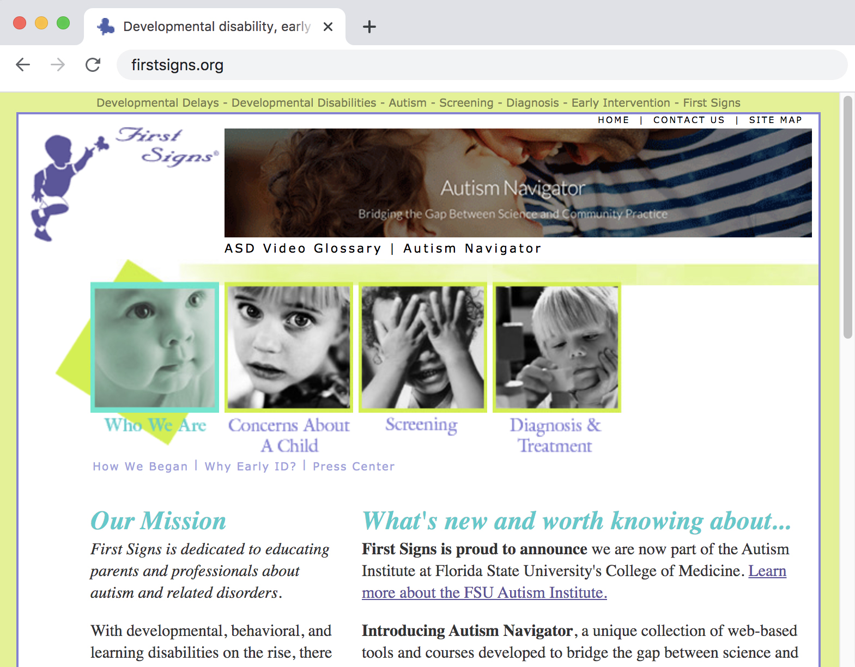
Guidelines for Talking to Families www.firstsigns.org

Slide 14
Set the Stage
Allow sufficient time for screening.
Talk in-person and in private.
Start by pointing out something positive, especially something that supports the parent-child relationship. Examples:
  “I noticed how your child turns to you for comfort.”
  “Your child is so curious and alert.”
  “I can see that you really know your child well.”
  “You’ve worked so hard to get help for your child.”
  “You’re so good at helping your child feel comfortable in this new environment.”
Notes:
Additional Talking Points
Starting with something positive …
Helps to build your connection with the parent.
Help them see that you notice the strengths and are not only focused on problems.
Help them listen to all that you have to say.
If you can identify a strength that also comments on the parent-child relationship, that has the added benefit of helping to strengthen that relationship.

Slide 15
Be Direct and Clear
Remind the parent about the purpose of the screening tool.
Ask the parent if they have any questions about the screening tool.
Share the screening results and your observations.
  Begin with areas in which the child is developing typically or are strengths for the child.
  Then share any areas of concern (if applicable).
Avoid using words like, “pass,” “fail,” “normal,” or “abnormal.”
Instead, talk about strengths and areas where help may be needed.

Slide 16
Listen and Empathize
Pause and encourage the parent to respond to what they heard.
Ask if this information fits the way they view their child.
If a developmental concern was raised, ask the parent if they were also concerned about this area, or if other family members have expressed concern.
Listen and be ready for any emotional responses.
If the parent is upset, respond with empathy but do not provide false reassurance. Possible responses include:
  “This is hard to hear.”
  “Even if you were already worried about your child’s language skills, it’s hard to hear me say it.”
  “This is a screening, not a diagnosis. That means it’s important to get more information to see if there are services that would help your child continue to develop.”
  “You were hoping that I could reassure you; I’m concerned, but I also know there is help available.”
Notes:
Additional Talking Points
These suggestions help parents to hear the information and gives them an opportunity to process what you are saying and integrate it with what they already know about their child.

Slide 17
Provide Recommendations and Referrals
Emphasize the importance of early identification and the availability of early intervention:
  “Most concerns or delays around language, play and interaction will not go away on their own. They can get worse over time if there is no intervention.”
  “Most children respond well to early intervention. Many improve with help and are better prepared for school.”
  “It’s important to get the help now while your child is young and developing quickly.”
Follow the referral algorithm to identify the best referral recommendation.
Provide information in writing:
  Information summary of screening measures
  Referral letter with the specific referral made
  CDC Milestones Moments booklet and/or ASQ Activity Sheets
If possible, follow-up if there was an area of concern or if a referral was made.
Notes:
Notes for Presenter
There is another training that provides information about referral resources for common developmental needs in early childhood.

Slide 18
Cultural Considerations
Listen to parents’ explanation regarding why they think the child has a delay (e.g., “Me echaron mal de ojo.”)
Provide parents with a gentle re-frame of why developmental delays occur.
Reassure them that they have not caused the delay.
Discuss services and interventions:
  Reassure parents that they are in charge; they can accept or decline any suggested intervention.
  Early intervention services can be provided in the home.
  Early intervention services are provided at no charge to the family.
  Early intervention staff members do not report to immigration.
Be open to hearing about alternative interventions and alternative healing practices.
Notes:
Additional Talking Points
It can be helpful to ask parents why they think the child has a delay.
For example, a parent might refer to Me echaron mal de ojo — the “evil eye.”
Another parent might think that something they have done (or not done) caused their child to have delays.
Other parents might dismiss concerns, indicating that they have a family member that “grew out of” a similar delay.

Slide 19
Cultural Competence Overview
Self-Awareness
Culture- Specific Awareness
Cultural Sensitivity
Notes:
Talking Points
Culture is often described as the combination of a body of knowledge, a body of belief and a body of behavior. It involves a number of elements, including personal identification, language, thoughts, communications, actions, customs, beliefs, values, and institutions that are often specific to ethnic, racial, religious, geographic, or social groups.
The concept of cultural competency has a positive effect on service delivery by enabling staff members to deliver services that are respectful of and responsive to the health beliefs, practices, and cultural and linguistic needs of diverse clients.

Slide 20
Cultural Competence
Learn about one’s own roots.
Examine values, behaviors, beliefs and customs of one’s own cultural heritage.
Learn about others’ cultures and values.
Consider diversity within and between cultural groups.
Make no assumptions about concerns, priorities and resources.

Slide 21
Cultural Considerations
Consider how we treat each other.
Show respect for all people.
Ask questions and avoid assumptions.
Treat others as you would like to be treated.
Apologize if you make a mistake or accidently offend someone.
Cultural competence is not a set skill but an ongoing process.
Reflective practice is a tool for the development of cultural competence.

Slide 22

Screening Bilingual or
Non-English-Speaking Children
Notes:
Talking Points
An area of cultural competence that comes up often in developmental screening contexts is the screening of bilingual children, or children whose primary language is not English.

Slide 23
Bilingual Development
Cognitive
Benefits
Academic
Benefits
Personal
Benefits
Societal
Benefits
Notes:
Talking Points
Bilingual development fosters:
Cognitive benefits: Increased creativity, better planning and problem solving, improved ability to attend to relevant information and ignore distractions
Academic benefits: improved ability to learn words with similar meanings more readily than monolinguals; enhanced English language; and other academic skills
Personal benefits: Greater access to people, literature, travel, employment opportunities
Societal benefits: Improved cultural understanding, improved ability to effectively serve communities.
*

Slide 24
MYTHS AND FACTS
About Bilingualism

Slide 25
MYTH 1
Bilingual children’s language development will be delayed.

Slide 26
FACT
Language milestones are the same for
bilingual and monolingual children.
  Classic study of 25 Spanish-English bilingual children and 35 children from monolingual homes.
  Language milestones were tracked from ages 8 to 30 months.
  Combining vocabulary in both languages, bilingual children had the same vocabulary as monolingual ones.
  If a bilingual child is not reaching typical milestones, seek help! It’s not because he or she is being exposed to 2 languages.
Notes:
Notes for Presenter
Source: Pearson, Fernandez, & Oller (1993). Lexical development in bilingual infants and toddlers: Comparison to monolingual norms. Language Learning, 43, 93-120.

Slide 27
MYTH 2
Children are confused by exposure
to two languages.

Slide 28
FACT
Some children may show cross-linguistic influence — rules from the more dominant language may get applied incorrectly in the less dominant language. Code-switching between languages is common.
  This is a typical part of bilingual language development.
  Children are good at figuring out when/with whom they should use which language.
  Code-switching/code-mixing is not a sign
  of confusion or delay.
Notes:
Additional Talking Points
Children should not be reprimanded for code-switching.
Parents should not be discouraged from raising their child bilingually because the child is code-switching. This is not a sign of a language delay/impairment.
Code-switching is not a sign of confusion.
Children will use words they know, rather than not say anything at all.
Many adults who are fluently bilingual continue to code-switch.

Slide 29
MYTH 3
Children with developmental delays or autism will have more delays if exposed to two languages.

Slide 30
FACT
Children do not show additional delays when exposed to more than one language.
In studies of children with autism, Down syndrome, and specific language impairment:
No difference in language development was found between bilingual vs. monolingual children.
Even if a child has delays, exposure to more than one language is not harmful.
Notes:
Notes for Presenter
Kay-Raining Bird et al. (2005). The language abilities of bilingual children with Down syndrome. American Journal of Speech-Language Pathology, 14, 187-199.
Hambly, C. & Fombonne, E. (2012). The impact of bilingual environments on language development in children with Autism Spectrum Disorders. Journal of Autism and Developmental Disorders, 42, 1342-1352.
Research on specific language impairment by Paradis and colleagues (French-English bilingual children) and by Gutierrez-Clellen and colleagues (Spanish-English bilingual children).

Slide 31
Encourage Bilingual Language Development
Advising parents to switch to a non-native language in the home can:
Negatively impact family relationships, as language is strongly connected with family culture.
Cause communication breakdowns.
Lead to parental stress.
Lead to parents providing a less rich language model to their child.
Notes:
Additional Talking Points
When parents are advised to stop speaking their native language to their child, this can cause problems in the parent-child relationship, and in the child’s communication development.
Experts recommend that parents should speak the language that is most comfortable to them. That way, they use the greater variety in vocabulary, use correct grammar, and connect emotions with communication.
Children who are exposed to good language models in their native language will more easily learn English when they start school.
*

Slide 32
Resources on Bilingualism
Websites:
American Speech-Language-Hearing Association (The Advantages of Being Bilingual, Teaching Your Child Two Languages, Becoming Bilingual/El Niño Bilingüe): www.asha.org
Head Start (The Importance of Home Language Series): https://eclkc.ohs.acf.hhs.gov/culture-language/article/importance-home-language-series
National Literacy Trust (Bilingualism: Frequently Asked Questions): www.literacytrust.org.uk
Center for Applied Linguistics (Bilingual and Dual Language Education):
https://www.cal.org/areas-of-impact/english-learners/bilingual-and-dual-language-education
Literature:
Paradis, J., Genesee, F. & Crago, M. B. (2010). Dual Language Development and Disorders: A Handbook on Bilingualism and Second Language Learning, 2nd Edition.
Wharton, R., Levine, K., Miller, E., Breslau, J., & Greenspan, S. (2000). Children with special needs in bilingual families: A developmental approach to language recommendations. ICDL Clinical Practice Guidelines. The Unicorn Children's Foundation: ICDL Press, pp. 141-151.

Slide 33
Practice Talking to Parents
About Screening Results
Notes:
Notes for Presenter
It can be helpful to encourage participants to pair up and practice talking with families about screening results and making referrals.
The following slides have vignettes for practice.

Slide 34
Martha, age 9 months
Martha is a 9-month-old girl.
Her mother brings her to an intake appointment. She does not complete the screening questionnaire. She says, “Martha is a baby and she’s doing fine.”
You know that Martha was removed for four weeks from her parents’ care due to domestic violence. Martha is now reunified with her mother.
How would you address the mother’s concerns about completing the measure?
Practice talking to Martha’s mother about the screening process.
Notes:
Notes for Presenter
After the practice, discuss as a large group. Some points to consider:
The screening should be presented as something that is given to all clients at intake and every six months thereafter (as follow-up).
The screening is voluntary, and the parent does not have to complete it if they are not comfortable. An alternative would be to ask questions about each domain of development and discuss with the parent typical milestones for her age.
Martha’s mother is probably anxious about being judged, given her history. Try to identify a strength that you observe during the visit. If you can note a strength in the relationship between Martha and her mother, that would be especially helpful to point out.
Be alert for any signs of distress and be ready with referrals for additional support.

Slide 35
Robert, age 24 months
Robert is a 24-month-old boy.
His father completed the ASQ-3 and ASQ:SE-2. However, he did not report any concerns about Robert and was not aware that Robert had delays.
Results from the ASQ-3 indicated delays on the following scales: Communication, Fine and Gross Motor, and Problem-Solving.
Robert’s father became upset when you started sharing the results.
Practice sharing screening results with Robert’s father.
Notes:
Notes for Presenter
Points to discuss in large group:
It can be difficult to stay calm and regulated when a parent becomes upset.
It is important to resist the urge to argue with a parent, but also resist the urge to back down and not share concerns.
When a parent is upset, slow down and shift to listening. Invite them to share their impressions of their child. Acknowledge that screening questionnaires are just one piece of information, and not a diagnosis.
Suggest that further assessment might help clear up what is going on.
If the parent is not open to a referral, suggest a re-evaluation sooner than usual. Provide child development materials in the meantime, such as the Milestones Moments app, or the ASQ Activities sheets.

Slide 36
Kathy, age 18 months
Kathy is an 18-month-old girl.
Her mother had several concerns with Kathy’s development.
When you score the ASQ-3 and ASQ:SE-2, scores are in the typical range except for the communication domain, which falls in the gray area.
On the ASQ:SE-2, Kathy’s mother checked the box re: concerns about Kathy’s behavior.
Kathy’s mother does not agree with the results and insists that the screening missed Kathy’s delays. She has particular concerns about Kathy’s tantrums and her difficulty communicating especially when she is upset.
Notes:
Notes for Presenter
Points to consider during discussion:
It is important to include a discussion with parent, in addition to formal screening scores, when determining next steps.
If a parent continues to be concerned, it is usually appropriate to make a referral. That way, additional assessment can be completed.
Also, sometimes there are concerns that are not well-covered by the screening instrument. In this case, a referral to behavioral health to address the tantrums can be helpful in also gathering more information about family dynamics, triggers for the difficulties, and parenting strategies, all of which could be helpful to the family.
It is rarely helpful to argue with families when there are differences of opinion. Rather, it is helpful to fully listen to and acknowledge parents’ concerns, share one’s own professional judgment, and discuss next steps that will help support parents while also gathering more information.

