Slide 1
DEVELOPMENTAL SCREENING: Administration, Scoring and Interpretation
Notes:
Notes for the Trainer
This training is designed for FRC staff who will be helping to administer the screening measures (e.g., giving the measures to parents to complete; helping parents to complete the measure) and scoring screening measures.
This training is designed for agencies using the ASQ-3, ASQ:SE-2, and M-CHAT-R measures. The presentation covers:
Tips for successful screening
Suggested talking points with parents
Required documents
ASQ-3: Overview, administration, sample scoring
ASQ:SE-2: Overview, administration, sample scoring
MCHAT-R: : Overview, administration, sample scoring
If you are not using some of the measures listed above, you may delete their slides as needed. If you are using different measures, these slides provide some guidance for how you might develop a training to fit the measure(s) you are using.
The Notes section of each slide provides suggested talking points, instructions and citations for the presenter to use as needed.
Approximate presentation time: 1 hour
Suggested venues: small group training sessions
Ages & Stages Questionnaires® is a registered trademark and ASQ-3TM, ASQ:SE-2TM and related logos are trademarks of Paul H. Brookes Publishing Co., Inc.
MCHAT-RTM is copyrighted 2009, Robins, Fein, & Barton.

Slide 2
The Perez Family: Miguel
Miguel is a 9-month-old boy
His mother walked into the FRC and completed the ASQ-3 and ASQ:SE-2 questionnaires.
She expressed concerns because Miguel cries “all the time” and she has difficulty keeping him on a consistent feeding and eating schedule.
Miguel’s mother was anxious to hear the results of the screening ….
To be continued . . .
Notes:
Notes for the Trainer
Begin the training by sharing this story about Miguel and his mother. The conclusion of this story will be presented later in the session (Slide 32).
You can also use a similar story about screening based on your own agency’s experience.
*

Slide 3
Tips for Successful Screening
Explain to the parents the screening process
Purpose
Importance
Next steps
Determine whether a parent needs additional help with the questionnaires
If a parent declines to complete measure, share the developmental guidance tools (Milestones Moments and/or ASQ Activity Sheets)
Notes:
Notes for the Trainer
Using the example of Miguel’s mother, discuss the importance of engaging parents in conversations about development screening.
*

Slide 4
Points to Make When Talking to Parents about the Screening
FRCs offers the opportunity to complete screening measures to all families.
Measures will help you understand how your child is developing.
The measures cover a range of ages — your child is not expected to be capable of performing all the skills yet.
If you don’t know the answer to a question, you can try out the skills, make your best guess, and ask for clarification about that item afterwards.
You will have an opportunity to review the results of the questionnaire. Be sure to ask any questions that come up about your child’s development.
Notes:
Notes for the Trainer
These are a handful of points that staff may wish to include in conversations with parents. Please add or delete according to agency preference/experience.

Slide 5
Materials Needed Before and After Screening
Completed summary page showing scores of screening measures
Milestone Moments booklet
Feedback letter (with developmental guidance activities)
Referral forms or contact info if applicable:
Early intervention program
School IEP
Mental health program
Plan for documenting information
Notes:
Notes for the Trainer
Listed on the slide are several materials that will be useful both before and after the screening is conducted. Please customize the list according to your agency’s procedures.
Plan ahead. Staff should have procedures in place that specify where materials are stored for easy access, as well as what format or medium the materials will be available in (e.g., paper, electronic, etc.).

Slide 6
SCREENING TRAINING: Ages & Stages Questionnaire-3 (ASQ-3)
Ages & Stages Questionnaires® and ASQ® are registered trademarks of and the ASQ logos are owned by Paul H. Brookes Publishing Co., Inc.
Copyright © 2018 Paul H. Brookes Publishing Co. All rights reserved.
Notes:
Notes for the Trainer
This is the first of three screening tools that will be covered.
If your staff will be trained to use the ASQ-3 as a screening tool, we recommend that your agency purchase the materials for the measure. These are copyrighted materials, but if your agency purchases a site license, you can print out measures as needed for training staff.
*

Slide 7
ASQ-3: Overview
Standardized screening measure
Accurately identifies children at risk for developmental delays
Encourages parent involvement
Parents learn about development while completing measure
Different ASQ-3 forms for different age ranges, from 2 to 60 months
Completed by parent/caregiver in 10-15 min.
Available in English, Spanish, and other languages
Notes:
Suggested Talking Points:
ASQ-3 is a standardized screening measure that is parent-focused and easy to use.
The tool accurately identifies children at risk for developmental delays across five different domains
ASQ-3 was designed to encourage parent involvement and help them learn about development while they’re completing the measure.
Ages 2 to 60 months (different forms for different ages)
The tool was designed to be completed by parent or caregiver in under 15 minutes.
It’s available in a variety of languages, including Spanish, Chinese, Vietnamese and Arabic.
Additional Talking Points
ASQ was initiated in 1980 at University of Oregon
The authors reviewed other standardized tests and studied the literature extensively to design a better tool for screening
ASQ skills were selected because they are easily observed or elicited by parents at home
First edition published in June 1995
ASQ-3 published in June 2009
*

Slide 8
ASQ-3: Domains
Communication:
language skills
Gross Motor:
coordination of arms and legs
Fine Motor:
coordination of hands and fingers
Problem Solving:
problem-solving skills and how to play with toys
Personal-Social:
self-help skills and interactions with others
Notes:
Suggested Talking Points
ASQ-3 accurately identifies children at risk for developmental delays across five key developmental areas

Slide 9
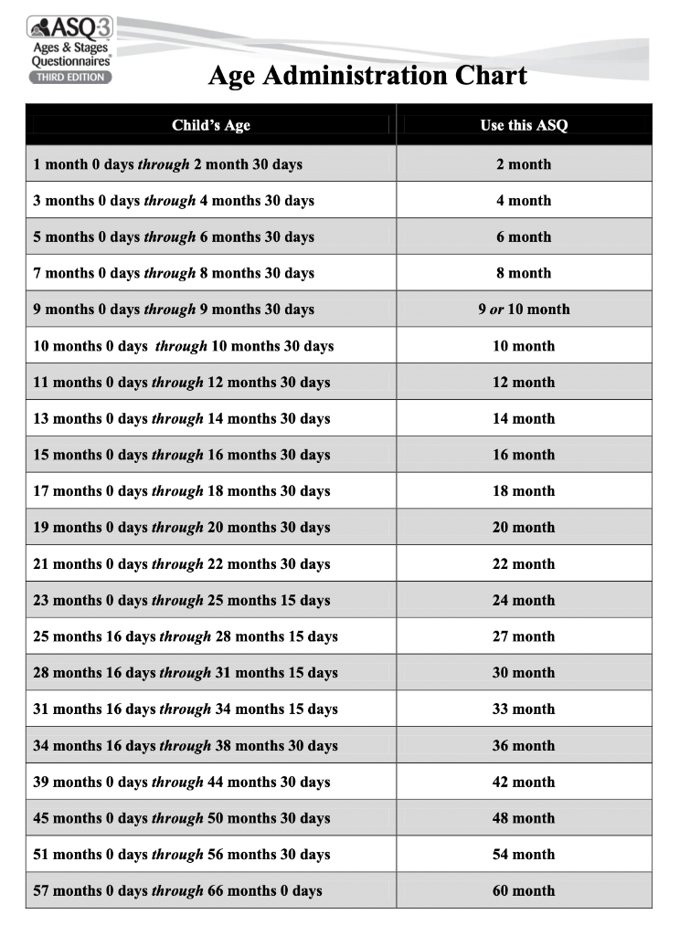
ASQ-3: Age Administration Chart
The first step is to select the correct ASQ-3 for the child’s age.
Excerpted from ASQ-3TM User’s Guide, By Jane Squires, Ph.D., Elizabeth Twombly, M.S., Diane Bricker, Ph.D., and LaWanda Potter, M.S. Brookes Publishing
Notes:
Notes for the Trainer
This slide assumes an agency is using the paper/printed version of the ASQ-3
If using the paper/printed version, we recommend that you print a handout for participants with the Age Administration Chart. This will show the correct measure to use for each age group.
You can then highlight the ages that you will be using for your screening initiative.
NOTE: If using the on-line version, the program will select the correct measure for the child’s age.
*

Slide 10
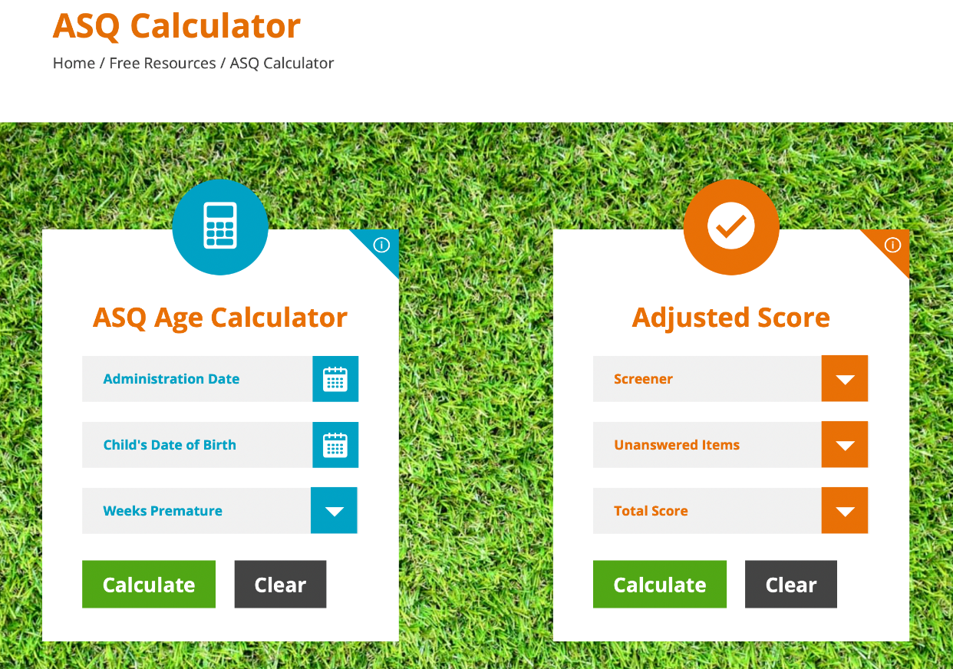
ASQ-3: Online Age Calculator
http://agesandstages.com/age-calculator/
Copyright © 2022 | Paul H. Brookes Publishing Co., Inc. All Rights Reserved.
*
Notes:
Note to Trainer
In addition to the age administration chart, there is an on-line calculator that allows you to quickly calculate the child’s age and which measure to select.
We recommend going to the website and showing the participants how to use it, by entering an administration date, child’s date of birth, and if applicable, number of weeks premature.
*

Slide 11
ASQ-3: Adjustment for Prematurity
Children are considered premature if born before 37 weeks of gestational age.
For an accurate screening, adjust the age for prematurity for children younger than 24 months.
Example: Alexandra is 18 months and 2 days old. According to the Age Administration Chart, she should be screened using the 18-month ASQ-3 tool. But because she was born six weeks premature, she will be screened with the 16-month ASQ instead.
Notes:
Notes for the Trainer
In children who are born prematurely, chronological age is not always the best indicator of where the child should be developmentally.
These children may take longer to reach some milestones than children born closer to their due dates, so lumping all kids of an age range together may result in unnecessary referrals due to concerns that are actually a result of prematurity.
To accurately check whether a child is reaching developmental milestones, it’s important to account for any factors that may impact screening results.
*

Slide 12
ASQ-3: Administration
Explain to parents how to complete the questionnaire.
Parents can answer questions by selecting one of three options: YES, SOMETIMES, or NOT YET.
In the Overall section, ask parents to check YES or NO for each question. If parents check YES, ask them to write an explanation.
Allow parents to complete the questionnaire independently, providing assistance when needed.
Notes:
Notes for the Trainer
The ASQ-3 is written at 4th- to 5th-grade reading level so it is easier for a a parent or caregiver to complete independently.
It is helpful to have someone available who can answer questions if the parent has difficulty understanding a question.
Your agency can purchase an ASQ-3 Materials Kit which is a bag of toys which a parent can use — they can try out some of the items with their child to see if they are able to do the skill.
*

Slide 13
ASQ-3: Scoring
Score each section of the questionnaire using the following point system:
Yes = 5
Sometimes = 5
Not Yet = 0
Notes:
Notes for the Trainer
The person who scores the ASQ-3 will vary by agency.
It takes about 2 minutes to score after a person is familiar with the scoring.
Suggested Activity:
Use the sample questionnaire to show how to score it.
For each item, write a number in the blank space to the right of the question. The numbers are shown above.

Slide 14
SAMPLE SCORING
Notes:
Notes for the Trainer
To practice scoring, insert a shot of a completed ASQ-3 section on this slide.
Ask training participants to indicate what score they would put in the blank space for each item.

Slide 15
ASQ-3: Scoring Steps
Write the score from each item in the blank to the right of each question.
Add the number of points and write in the total number for that specific domain
Communication Total ___, Gross Motor Total___ etc.
Section 1 of “ASQ-3 Information Summary” page
Transfer the total score for each domain in the Total Score column.
Notes:
Notes for the Trainer
Direct the audience to look at the Information Summary page (the last page in their sample ASQ-3).
Ask them to complete the steps as indicated.

Slide 16
ASQ-3: Scoring Steps (cont’d)s
Fill in the circles with the corresponding score for each domain
Transfer the Overall responses into Section 2 of the scoring sheet by circling “yes” or “no” (depending on the parent’s response to each question).
Notes:
Notes for the Trainer

Slide 17
PRACTICE SCORING
Notes:
Notes for the Trainer
Provide a sample of an ASQ-3 form with answers (i.e., as if a parent completed the form).
Fill in the correct score for the items in the first domain, the Total for that domain, and the bubbled number in the Information Summary for that domain, as an example.
Have the participants fill in the scores for the other domains and the totals for each domain.
Have participants check their answers by providing them with the correct Total Scores for each domain.
Confirm that all participants have the correct scores and answer any questions for people who came up with a different score)
Ask participants to fill in the bubbles on the Information Summary page.
You can also provide a completed Information Summary page for your example, so that participants have the correct version to compare their answers to.

Slide 18
ASQ-3: Scoring Omitted Items
Try to obtain answers from parent; encourage them to make their “best guess.”
A maximum of two (2) items can be omitted.
Steps to take when 1-2 items are omitted:
Calculate the average score for the answered questions in that domain (divide the total score by the number of questions answered in that domain).
Add that number (the average score) to the total score to get a new Total Score for that domain.
Notes:
Notes for the Trainer
One complication occurs when a parent omits one or more items when they are completing the questionnaire.
If more than 2 items are omitted, then the questionnaire cannot be accurately scored.
If there are 1 or 2 items missing and the parent cannot choose an answer, then follow the procedure for “omitted items.”
We’ll show an example on the next slide and you’ll get a chance to practice.
*

Slide 19
ASQ-3: Example of Omitted Items
Divide total domain score by the number of items answered in that domain. Example: The domain has 6 items, and the parent only answered 5 of them. The total score for the 5 items that were answered is 45.
45 (area score) ÷ 5 (items) = 9 points.
Add this average item score to the total domain score to get a new total score.
45 + 9 points = new total of 54 points
Notes:
Notes for the Trainer
This method helps us to make the “best guess” about what the score would have been if the parent had filled it in. The best guess is based upon the other scores in that area.
For example, if 5 items were answered with “5”, what would the best guess be for the 6th item? (answer: 5). Show how 5*5/5 =5.
Repeat with 5 items answered with “10.” The best guess for the 6th item would be 10. Show how 10*5/5 = 10.
Participants should know that the need to omit items does not happen very often. Items should only be omitted if they are inappropriate to try with a child.
For example, the mirror items are inappropriate because of cultural and spiritual beliefs to some families.
However, if the only reason an item is omitted is lack of opportunity, the child should be given the opportunity to practice and try the item.

Slide 20
PRACTICE OMITTED ITEMS
Notes:
Notes for the Trainer
We recommend that you copy a section of the ASQ-3, where all but one answer is completed.
Have the participants try figuring out what the Total Score should be, using the omitted items calculation.
Provide them the correct response and answer any questions for people that had difficulty getting the correct answer.
Show on the Information Summary page how, if you did not give “credit” for that omitted item, a child’s score could appear very low in that domain.
Giving credit for the omitted item — by using the “best guess” of what it would have been — will produce a more accurate score.

Slide 21
ASQ-3: Interpretation
Possible Concern: Problem
Monitoring Range: May have a problem
Typically Developing Range: No Problem
Parent concerns
Notes:
Notes for the Trainer
The Information Summary shows three levels of concern (outlined above).
In addition to looking at the scores, FRC staff will be discussing any concerns that the parent brings up or any concerns noted in Section 2 of the Information Summary page.
FRC staff will be reviewing the results with the family and making recommendations and referrals if there is an area of concern.
Note: When reviewing screening results with families, avoid using terms like “pass” and “fail.”
*

Slide 22
SCREENING TRAINING:
Ages & Stages Questionnaires:
Social-Emotional,
2nd Edition (ASQ:SE-2)
Ages & Stages Questionnaires® and ASQ® are registered trademarks of and the ASQ logos are owned by Paul H. Brookes Publishing Co., Inc.
Copyright © 2018 Paul H. Brookes Publishing Co. All rights reserved.
Notes:
Notes for the Trainer
This section will cover the second screening tool, ASQ:SE-2
Similar to ASQ-3, if your staff will be trained to use this tool, we recommend that your agency purchase a site license. This will allow you to print out measures and other materials as needed for training staff.

Slide 23
What Is The ASQ:SE-2
Questionnaire that identifies young children at risk for social or emotional difficulties
Designed for parents to complete
Research shows that if only the ASQ-3 is administered, many children who have social-emotional needs will be missed.
Copyright © 2022 | Paul H. Brookes Publishing Co., Inc. All Rights Reserved.
Notes:
Notes and Suggested Talking Points for the Trainer
Modeled after ASQ-3, the ASQ:SE-2 is tailored to identify and exclusively screen social and emotional behaviors.
ASQ:SE-2 is an easy-to-use tool that’s cost-effective, parent-completed, photocopiable, and culturally sensitive.
When the same children were given both the ASQ-3 and the ASQ:SE-2, many children had concerns noted on the ASQ:SE-2 but their ASQ-3 did not show any areas of concern. Therefore, it is important to specifically screen for social-emotional needs.*
*Williams, M. E., Zamora, I., Akinsilo, O., Hickey Chen, A., & Poulsen, M. K. (2018). Broad developmental screening misses young children with social-emotional needs. Clinical Pediatrics, 57, 844-849)

Slide 24
ASQ:SE-2 Domains
Self-Regulation: Does your child settle herself down after exciting activities?
Compliance: Does your child do what you ask him to do?
Communication: Does your child look at you when you talk to her?
Adaptive Functioning: Does your child stay away from dangerous things, such as fire and moving cars?
Autonomy: Does your child cling to you more than you expect?
Affect (mood): Does your child seem happy?
Interactions with People: Does your child try to hurt other children, adults or animals (for example, by kicking or biting)?
Notes:
Notes and Suggested Talking Points for the Trainer
ASQ:SE-2 features questions that are intended to assess seven domains: self-regulation, compliance, social-communication, adaptive functioning, autonomy, affect, and interaction with people.
Unlike the ASQ-3, which has separate scores for the different domains, the ASQ:SE-2 has only one total score for the domains.

Slide 25
ASQ:SE-2 Scoring
Response to each item can be:
“Often or always”
“Somewhat”
“Rarely or Never”
In addition, parents are asked to check items that they are concerned about.
Notes:
Notes for the Trainer
Using the example of Miguel’s mother, discuss the importance of engaging parents in conversations about development screening.

Slide 26
ASQ:SE-2 Scoring
Each response option has a letter (z, v, or x) next to it that indicates what numerical score to give that response.:
z = 0 points
v = 5 points
x = 10 points
If the parent also checked the “concern” box, add 5 additional points.
Write the total number of points in the blank to the right of the question for each item.
Notes:
Notes for the Trainer
Note that the placement of the responses receiving 0, 5 or 10 points varies depending on the question.
For some questions, the first answer choice gets a score of “0,” and for others, the right-hand answer choice gets a score of “0.”
Be sure to look at the small letters to determine what items scored a five.

Slide 27
PRACTICE SCORING ASQ:SE-2
Notes:
Notes for Trainer
Substitute this slide with an image showing a section of the ASQ:SE-2 with a few responses filled in.
Demonstrate that “z” is sometimes placed as the leftmost answer and other times as the rightmost answer.
Go through the correct score for each item on the screen.

Slide 28
ASQ:SE-2 Summary Sheet
Transfer “Total Points” on each page to the summary sheet.
Add up all Total Points in section 1 for the “Total Score.”
Transfer Total Score to the box next to the cutoff score.
If the Total Score is higher than the cutoff, then there is a concern, and a referral should be made.
Section 3: Circle “yes” or “no” for each question.
Notes:
Notes for the Trainer
Guide participants through the scoring process.

Slide 29
ASQ:SE-2 SUMMARY SHEET SAMPLE
Notes:
Notes for the Trainer
Substitute this slide with an image showing a section of the ASQ:SE-2 summary sheet that shows a score above the cutoff.
Note that, for the ASQ-3, a lower score represents a problem (as opposed to the ASQ:SE-2, where a higher score means a problem)

Slide 30
ASQ:SE-2: Scoring Omitted Items
Check for missing items and ask parents to try to answer.
If 1-2 items are missing: Go ahead and score the usual way.
If 3 or more items are missing: Determine if the total score is within 5 points of the cutoff.
If no: do not adjust score.
If yes: score must be adjusted (see next slide).
Notes:
Notes for the Trainer
One complication occurs when a parent omits several items when completing the questionnaire.
If 1 or 2 items are omitted, then the questionnaire cannot be accurately scored.
If 3 or more items are missing, you will need to determine if the total score is within 5 points of the cutoff.
NO: If it is not within 5 points, do not adjust the score.
YES: If it is within 5 points of the cutoff, you will need to adjust the score. Additional information is provided in the next slide.

Slide 31
ASQ:SE-2: Adjusting the Score
Divide the total score by the number of items parents answered. That gives you the average score per item.
Use that average score for each missing item. For example:
Parent omitted 3 items (answered 30 out of 33 questions)
Total score = 80
Divide 80 by 30 = 2.66 (the average score)
Add 2.66 to each unanswered question: 3 (no. of missing items) x 2.66 points = 7.98 (Can round up to 8)
Add to total score: 80 + 8 = 88
Notes:
Notes for the Trainer
The process of adjusting for omitted items is similar to what was done in the ASQ-3.

Slide 32
Miguel’s Results…
Please score the ASQ-3 and ASQ:SE-2 screening measures and determine if there are any areas of concern based on the results.
Please debrief with your partner and as a group.
Notes:
Notes for the Trainer
In our trainings, we created a sample of an ASQ-3 and an ASQ:SE-2 for Miguel, age 10 months, the child who was introduced in the first slide.
Fill in the items as if the parent completed them.
The audience then scores each item and completes the Summary pages for each measure. This is helpful as extra practice.
Some groups enjoy timing themselves to see how quickly they can score the ASQ. This practice helps show that it is not a time-consuming activity.
*

Slide 33
ASQs: Frequently Asked Questions
Q: Isn’t the staff member’s impression of the child’s development more accurate than that of the parents?
A: The ASQ is designed to be completed by a parent who knows the child well. This information is then combined with the staff member’s expertise to determine the best approach for any concerns that arise.
Q: What if the provider does not see the problems that the parent is reporting on the questionnaire?
A: Defer to the parent because they have the opportunity to observe the child in many different settings.
Q: Can the questionnaire be completed by a babysitter/other family member?
A: The ASQ:SE-2 can be completed by anyone who has 20 or more contact hours per week with a child.
Q: I’ve noticed when the ASQ:SE-2 is completed by two different caregivers, the scores come out different. How do we know which one is right?
A: Scores may differ since a child's behavior will often be different in different settings and with different caregivers. There are no right and wrong answers.
Notes:
Notes for the Trainer
This slide presents a few of the most frequently asked questions regarding ASQs.

Slide 34
SCREENING TRAINING: Modified Checklist for Autism in Toddlers (Revised) (M-CHAT-R)
© 2009 Diana Robins, Deborah Fein, & Marianne Barton
Notes:
Notes for the Trainer
Using the example of Miguel’s mother, discuss the importance of engaging parents in conversations about development screening.

Slide 35
Disparities in Screening for ASD?
Referral, diagnosis and treatment may be late or reduced for:
Children of color, particularly Latino and Black children
Children with less severe symptoms and delays
Children from lower-income backgrounds
Consistent screening helps reduce disparities and ensures children get connected with early intervention.
Notes:
Suggested Talking Points for the Trainer
Like developmental screening, screening for Autism Spectrum Disorder (ASD) and referral for subsequent specialized developmental services greatly improves long-term outcomes for children.
However, ASD referral, diagnosis and treatment may be late or reduced, especially for young children of color, children who display less severe symptoms, and children from low-income households.
While screening tools such as ASQ:SE-2 contain items designed to detect behavioral and communication concerns that may point to autism, ASQ:SE-2 is not an autism screener.*
Citation
* ”Your Top ASQ:SE-2 Questions Answered.” Retrieved from https://agesandstages.com/free-resources/articles/top-asqse-2-questions/.

Slide 36
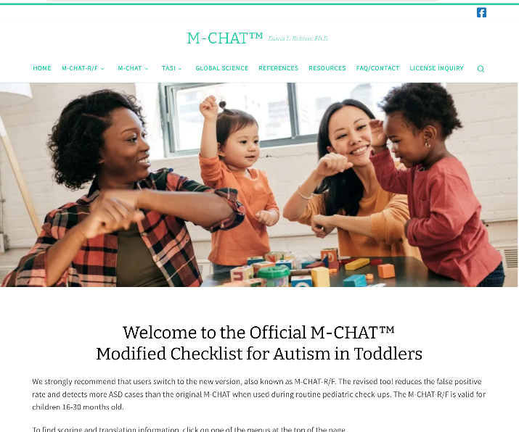
M-CHAT-R: Overview
Parent-report screening tool
Standardized questionnaire
Validated for children between 16-30 months
20 items with Yes/No responses
Translated into multiple languages and used in many countries
Available for free at www.mchatscreen.com
Notes:
Suggested Talking Points for the Trainer
The Modified Checklist for Autism in Toddlers-Revised (or M-CHAT-R) is a 2-stage parent-report screening tool that assesses risk for ASD.
The M-CHAT screening tool detects many cases of ASD in toddlers, with most screen-positive cases warranting evaluation and referral for early intervention.*
The copyrighted tool is available for free download for clinical, research, and educational purposes.
It is available in a variety of languages, including Korean, Spanish, Tagalog, Chinese (Cantonese, Mandarin and Taiwanese), and Vietnamese.
Citations
* Robins, D. L., Casagrande, K., Barton, M., Chen, C. A., Dumont-Mathieu, T., & Fein, D. (2013). Validation of the Modified Checklist for Autism in Toddlers, Revised with Follow-up (M-CHAT-R/F). Pediatrics, peds.2013-1813; DOI: https://doi.org/10.1542/peds.2013-1813.

Slide 37
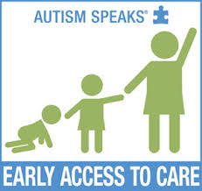
M-CHAT-R: Overview
MCHAT-R Items as predictors of ASD:
Best discriminators of ASD:
Points to show interest
Responds to name
Shows interest in other children
Brings objects to show
Follows point
Imitates actions
Responds to smile
Notes:
Suggested Talking Points for the Trainer
Research has shown that the M-CHAT screening tool is very effective in identifying cases of ASD in toddlers.*
The tool incorporates a series of YES or NO questions that detect risk of ASD.
FRC staff can work with parents to complete the questionnaire.
Citation
*Weitlauf, A. S., Vehorn, A. C., Stone, W. L., Fein, D., & Warren, Z. E. (2015). Using the M-CHAT-R/F to Identify Developmental Concerns in a High-Risk 18-Month-Old Sibling Sample. Journal of developmental and behavioral pediatrics : JDBP, 36(7), 497–502. doi:10.1097/DBP.0000000000000194

Slide 38
M-CHAT-R: Scoring
If you point at something across the room, does your child look at it? (FOR EXAMPLE, if you point at a toy or an animal, does your child look at the toy or animal?)
Yes (0) No (1)
Does your child play pretend or make-believe? (FOR EXAMPLE, does your child pretend to drink from an empty cup, pretend to talk on a phone, or pretend to feed a doll or stuffed animal?)
Yes (0) No (1)
Notes:
Notes for the Trainer
Pass out sample of the questionnaire.
For each item (except the three on the next slide), an answer of NO is scored with 1 point.

Slide 39
Reverse Scoring
Note: For items 2, 5, and 12, “YES” indicates risk of ASD
Have you ever wondered if your child might be deaf?
YES (1) NO (0)
Does your child make unusual finger movements near his or her eyes? (For example, does your child wiggle his or her fingers close to his or her eyes?)
YES (1) NO (0)
Does your child get upset by everyday noises? (For example, does your child scream or cry in response to noise, such as a vacuum cleaner or loud music?)
YES (1) NO (0)
Remember that, except for the reverse scoring questions:
Yes (0) No (1)
Notes:
Notes for the Trainer
Note that, for the items on this slide, an answer of YES is scored with 1 point.

Slide 40
M-CHAT-R: Interpretation and Follow-Up Recommendations
HIGH-RISK: Total score is 8-20 (Problem)
Refer for diagnostic evaluation and eligibility evaluation for early intervention.
MEDIUM-RISK: Total score is 3-7 (Possible problem)
Administer the follow-up interview (second stage of M-CHAT-R/F) to get additional information about at-risk responses.
LOW-RISK: Total score is 0-2 (No problem)
If child is younger than 24 months, screen again after second birthday.
Notes:
Notes for the Trainer
After completing the questionnaire, FRC staff will add up the points.
Review the scoring algorithm provided to determine risk of ASD.

Slide 41
M-CHAT-R: Follow-up Questions
If the total score is 3-7, the staff member should use the guide for follow-up questions to get more information that will help decide if the child is at high risk and if they should be referred for additional evaluation.
Notes:
Notes for the Trainer
If applicable, pass out the follow-up interview guide for the M-CHAT-R and practice going through the decision tree. This will be dependent on who is scoring, interpreting, and/or providing referrals.

Slide 42
M-CHAT-R: Case Exercise
Please score the sample M-CHAT-R and review the results as a group.
Notes:
Notes for the Trainer
Complete a sample M-CHAT-R.
Be sure to score a “high risk” response for one of the reverse items (items 2, 5 and 12), so participants will have the opportunity to practice catching those items.
Have each participant score the measure and then share the correct score.
Discuss any questions to ensure everyone understands how to score.

Slide 43
THANK YOU!

