Slide 1
Developmental Screening Overview

Slide 2
Introduction
Early Recognition of Child Development Problems
Public domain video courtesy of CDC
Notes:
Notes for Presenter
The presentation can be started by sharing this introductory video with the audience.
Video 1: Early Recognition of Child Development Problems”
Run time: 4:33
This is 4-1/2-minute educational video, produced by the Centers for Disease Control and Prevention (CDC), explains the importance of identifying problems in child development early. It shows some key developmental milestones in the first few years of life, shows a pediatrician talking to a parent during a well-child visit, and explains the importance of parents mentioning their concerns with their child’s physician.
http://www.youtube.com/watch?v=KrUNBfyjlBk

Slide 3
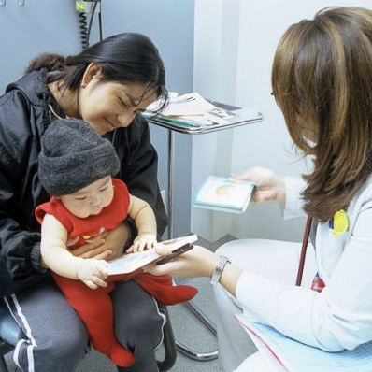
In the United States . . .
14 to 17 percent of children have a developmental or behavioral delay or disability.
Fewer than half of these children are identified before starting school.
Only 10 percent of children with delays received early intervention services.
In California, only 14% of children birth to age 5 receive standardized developmental screening.
Notes:
Additional Talking Points
The most common areas of delay are speech, language, and communication.
If delays are not addressed, children may not be ready to learn when they start school.
When delays are identified early, there are early intervention programs that can significantly improve children’s developmental trajectories and outcomes.
Citations
References re incidence of developmental delay/disability:
https://www.mass.gov/files/documents/2016/08/xf/importance-developmental-milestones.pdf
https://www.cdc.gov/ncbddd/developmentaldisabilities/facts.html
Only 10 percent of children with delays receive early intervention services:
Rosenberg, S. A., Zhang, D. & Robinson, C. C. (2008). Prevalence of developmental delays and participation in early intervention services for young children. Pediatrics, 121, 10.1542/peds.2007-1680.
Only 14 percent of children in California receive standardized developmental screening:
Burak & Odeh (2018, March 6). Developmental Screenings for Young Children in Medicaid and the Children’s Health Insurance Program.
https://ccf.georgetown.edu/wp-content/uploads/2018/03/Dev-Screening-3-15.pdf

Slide 4
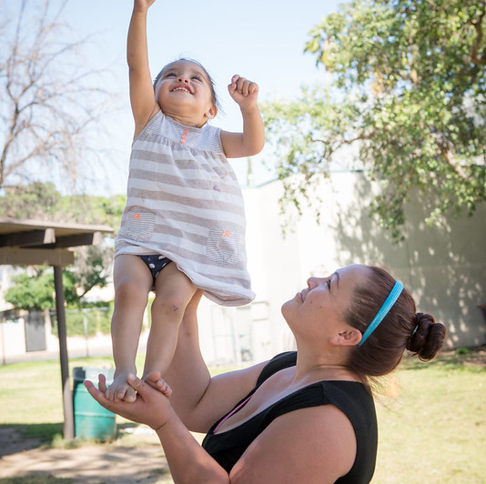
One Family’s Story . . .
Ms. Gallegos walked into the Family Resource Center (FRC) asking for help for Carla, her 18-month-old child. A family support specialist sat down with Ms. Gallegos and invited her to complete several screening measures, including an ASQ-3, ASQ:SE, and M-CHAT-R. Based on the screening, there were red flags for autism and concern for language delay.
Notes:
Notes for Presenter
[Can replace with a success story from your own agency if appropriate]

Slide 5
One Family’s Story . . .
The FRC was located next door to the local regional center, so the family support specialist was able to introduce Ms. Gallegos to an Early Start staff member who told her about the early intervention program. Carla received a full evaluation by the early intervention assessment team. The speech-language pathologist found that she had a language and communication delay, but the other domains of development were in the typical range.
Notes:
Notes for Presenter
[Can replace with a success story from your own agency if appropriate]

Slide 6
One Family’s Story . . .
Carla started services twice weekly in the home. The speech therapist worked directly with Carla, while her mother participated in the “It Takes Two to Talk” group, where she learned strategies to support Carla’s communication efforts. By the time she turned 3, Carla’s language and communication skills were age-appropriate. Her early intervention team helped link her to a Head Start preschool, where she is thriving.
Notes:
Notes for Presenter
[Can replace with a success story from your own agency if appropriate]

Slide 7
Early Intervention Leads to Positive Outcomes
Children birth to age 3 with delays can receive early intervention services such as . . .
Speech and language therapy to help with communication.
Occupational or physical therapy to help with walking, picking up small objects, or eating independently.
Behavioral or mental health services to help with socialization, self-regulation, bonding and attachment with caregivers.
Many children who received early intervention services no longer need special help by the time they reach preschool or kindergarten.
For those who do continue to have special needs, early identification helps children get access to special education services in preschool and kindergarten.
Notes:
Suggested Talking Points
This study focused on more than 3,000 children who received early identification services and then later went on to kindergarten.
More than one-third (37%) of these children did not need preschool special education services, and more than one third (32%) did not need kindergarten special education services.
For those children that had delays but did not end up having a developmental disability, kindergarten teachers rated estimated approximately 82% as having normal thinking and reasoning skills for their age.
Citations
Hebbeler et al. (2007). Early intervention for infants and toddlers with disabilities and their families: Participants, services, and outcomes. Final report of the National Early Intervention Longitudinal Study (NEILS). Menlo Park, CA: SRI International. https://www.sri.com/wp-content/uploads/2021/12/neils_finalreport_200702.pdf

Slide 8
[Agency Name] [name of screening program]
Developmental Screening Initiative
Our agency is launching an initiative to increase our rates of developmental screening.
You are all part of this important effort.
Notes:
Notes for Presenter
This content can be edited to fit your agency needs.
Place the agency name and the name of your new screening program in the heading
Add bullet points to the slide as needed.

Slide 9
Why [Agency Name]? Our Mission
Our mission is
__________________________________________________.
Notes:
Notes for Presenter
The purpose of this slide is to link this screening initiative to your agency’s mission.
Please add your mission statement.

Slide 10
[Agency Name] Challenges
Challenge 1
Challenge 2
Challenge 3
Notes:
Notes for Presenter
This slide should be customized to your agency. Describe:
What are the challenges that your Center has faced with identifying children who need early intervention services?
What are challenges in your community in terms of underserved groups, or delayed identification?

Slide 11
[Agency Name] Commitment:
Our Goals:
Give staff members the tools to have developmental conversations with parents and caregivers.
Promote early identification of developmental disorders
Improve linkages to services in community.
Conduct outreach to underserved populations in our community.
We plan to address this [insert challenge]
Notes:
Notes for Presenter
This slide can be customized to show the overarching purpose of your developmental screening program and the goals you have identified.

Slide 12
[Agency Name]: Current Practices
Talking with parents about their concerns about their child’s development, but not using a standardized screening tool.
Providing parents with suggestions of community resources to support their child’s development.
Occasional outreach events to tell people about our family resource center.
Notes:
Notes for Presenter
Customize this slide as needed. Describe: What is the current state of your efforts to identify children with developmental delays? Some examples are provided to get you started.

Slide 13
Developmental Screenings
Brief standardized tools that:
Can be completed by a parent/caregiver.
Provide an opportunity for developmental conversations.
Allow staff members to collaborate with parents to describe and discuss all domains of a child’s development.
Help to identify parents’ concerns and children’s needs.
Notes:
Notes for Presenter
This provides a brief explanation of the benefits of using developmental screening tools.

Slide 14
Why Screen?
Under-detected
Clearly Typical
Clearly Atypical
Adapted from Macias, M. (2006) D-PIP Training Workshop
Notes:
Notes for Presenter
This slide and the next are intended to illustrate the limited effectiveness of developmental monitoring and the need for developmental screening.
Suggested Talking Points
Developmental monitoring is highly effective in recognizing developmental delays.
95% of children referred by staff members did indeed have a developmental delay.
So those children who are clearly atypical or clearly delayed are already being identified by most staff members.

Slide 15
Why Screen?
Under-detected
Clearly Typical
Clearly Atypical
Adapted from Macias, M. (2006) D-PIP Training Workshop Copyright © 2011 Paul H. Brookes Publishing Co., Inc. All rights reserved. www.agesandstages.com
Notes:
Suggested Talking Points (continued)
HOWEVER, monitoring is not sensitive enough to identify children who are in the “gray area” due to being neither clearly typical or clearly atypical.
For instance, one study looked at a pediatric practice in Oregon, when both standardized and informal screening methods were used.
The study found that 67 percent of the children identified by a standardized screening tool were not identified when relying on informal monitoring.

Slide 16
[Agency Name] Standardized Screening Measures
Ages & Stages Questionnaires, Third Edition (ASQ-3)
Ages and Stages Questionnaires: Social-Emotional, Second Edition (ASQ:SE-2)
Modified Checklist for Autism in Toddlers (M-CHAT)
Notes:
Notes for Presenter
This slide is intended to provide additional details to agency staff about the new screening initiative. Prior to the presentation:
Modify the slide to include the specific screening tools that your agency will be using. Three screening tools have been listed here as examples.
Determine the process and population you will be working with.
Suggested Speaking Points
Our agency will begin using the following standardized screening tools [list tools].
We will be serving (describe population) who come to our agency as a result of [outreach, walk-ins or other].

Slide 17
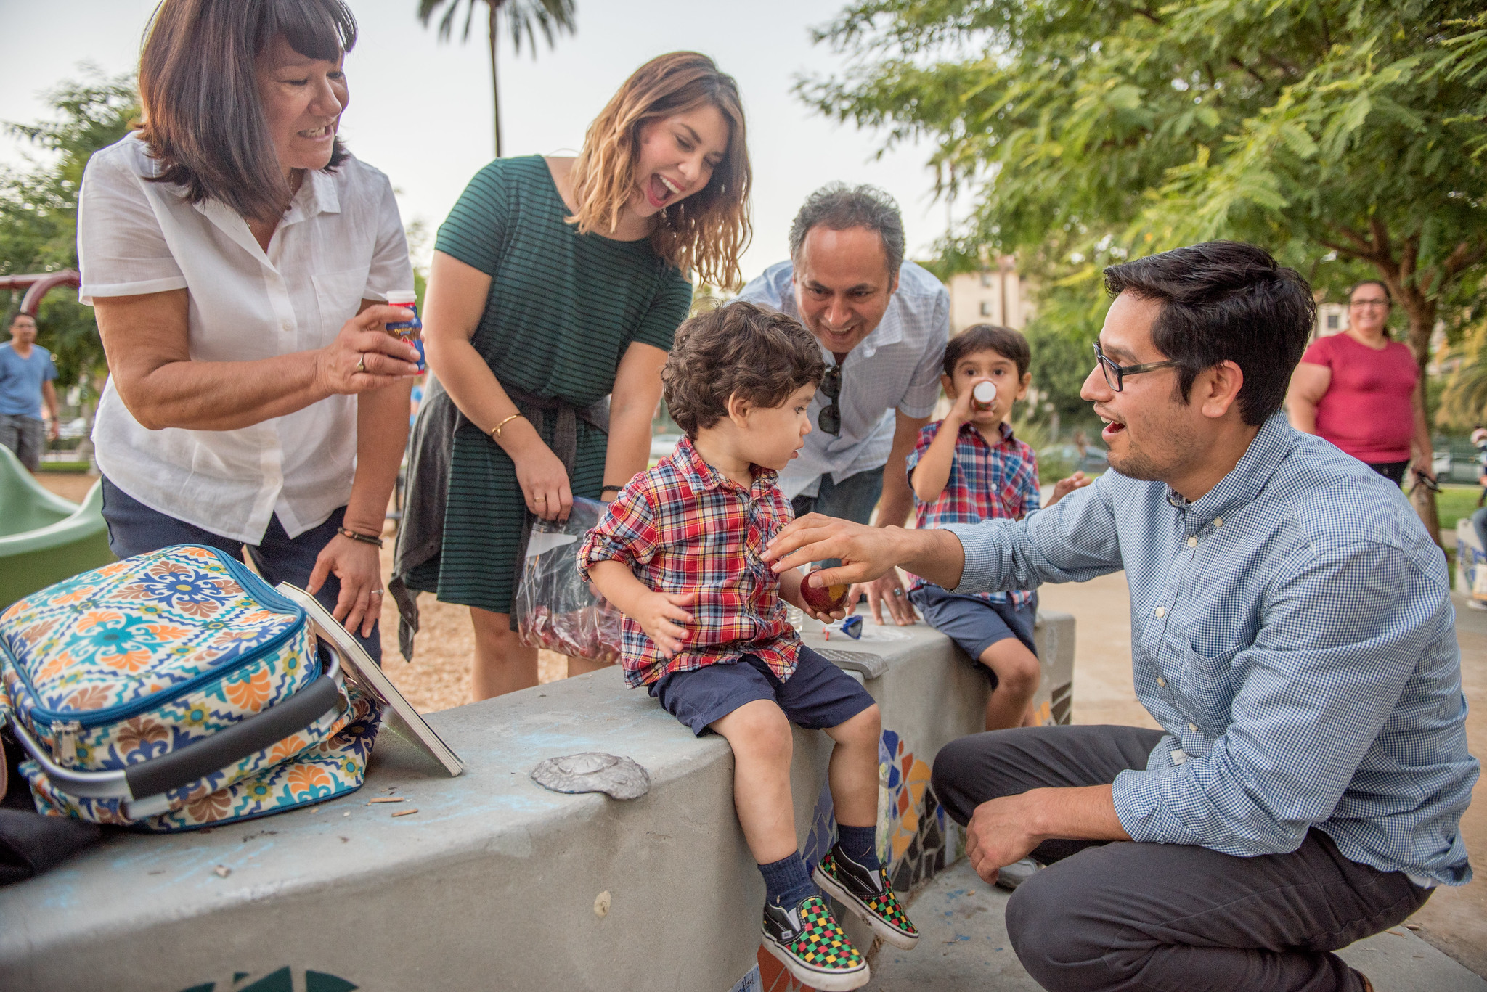
It Takes a Whole Team!
Notes:
Notes for Presenter
Please use this slide to engage staff in the new developmental screening initiative. Consider inserting a photo of the entire staff or images of staff working with families.
Suggested Talking Points
A successful developmental screening initiative is a team effort. It’s important for everyone to know and play their part.
As we go through the workflow for our agency, notice the important role(s) that you will be asked to fill.
Each part of the workflow needs to go smoothly so that no children fall through the cracks.

Slide 18
Workflow: In-House Screening
Points of Entry for Families:
Walk-ins, phone calls, emails (if call or email, parent is asked to walk-in)
Family Support Specialist scores screening measures and identifies referral resources.
Family Support Specialist talks with parent/caregiver to learn about their concerns or questions
Family Support Specialist initiates developmental conversation with parents, discusses screening results, and provides Milestones Moments booklet and/or app.
Family Support Specialist selects correct screening forms for the child’s age and parent’s preferred language.
If indicated, Family Support Specialist provides referrals to address developmental concerns.
Parent completes screening measures with support from Family Support Specialist.
In one month, Family Support Specialist contacts parent to check on linkage and provide additional support if needed.
Notes:
Notes for Presenter
This slide and the next can be used to illustrate to your audience what screening would look like at your agency, e.g., the steps in the screening process, the individuals involved at each step. Please modify to fit your agency’s workflow and staff roles. Make sure to highlight the roles that are relevant for members of your intended audience.
This slide shows a sample workflow for a family resource center that conducts in-house screening.

Slide 19
Workflow: Outreach Screening (Library example)
Develop partnerships with community sites for outreach.
Parents complete screening measures with support from Family Support Specialist.
Family Support Specialist scores screening measures and identifies referral resources.
Family Support Specialist prepares talking points regarding developmental screening and brings screening measures in a range of ages and languages.
Family Support Specialist meets individually with parents for developmental conversation, discusses screening results, and provides Milestones Moments booklet and/or app.
Family Support Specialist provides information to a group of parents about developmental screening and invites parents to complete screening measures.
If indicated, Family Support Specialist provides referrals to address developmental concerns.
Notes:
Notes for Presenter
Similar to the last one, this slide can be used to illustrate what screening would look like at your agency.
This particular slide shows a sample workflow for a family resource center that does outreach screening, specifically at a group library event.
Please modify to fit your agency’s requirements.

Slide 20
Next Steps: Training
Training Description | Staff to Be Trained
Administer and score screening tools.
Interpret the scores and discuss results with parents.
Link children and families to community resources.
Notes:
Notes for Presenter
This slide can be used to provide information to staff regarding the agency’s plan for training personnel. Please modify to fit your agency’s requirements.
Consider including the following information:
Specific duties (e.g., administer and score screening tools)
Staff positions to be trained
Persons responsible for training

Slide 21
Countdown to Launch and Spread
(Month, Year): In-house screening starts
(Month, Year): Outreach partners identified
(Month, Year): Outreach events start
Goal:
Our goal is to conduct ___ outreach events by __________, and screen ___ number of children by __________.
Notes:
Notes for Presenter
This slide can be used to provide information to agency staff regarding the timeline of activities. Please modify to fit your agency’s plan and schedule.
The example provided below is for a family resource center planning to do in-house and outreach screening:
Sample Timeline:
October 2022: In-House Screening starts
December 2022: 10 outreach partners identified
April 2023: Outreach events start
Sample Goal:
Our goal is to conduct 10 outreach events by April 2023 and screen 150 number of children by December 2023.

