Slide 1
DEVELOPMENTAL SCREENING: Administration, Scoring, and Interpretation
Notes:
This training is designed for the people who will be helping to administering the screening measures (e.g., giving the measures to parents to complete; helping parents to complete the measure); and scoring screening measures. In some agencies, these roles will be completed by home-based educators. In other clinics, child developmental specialists may fill these roles. This training is designed for agencies using the ASQ-3, ASQ:SE-2, and M-CHAT-R measures. If you are using some but not all of those measures, you can select only the slides you need. If you are using different measures, these slides provide some guidance for how you might develop a training to fit the measure(s) you are using.

Slide 2
The Perez Family: Miguel
Miguel is a 9-month-old boy.
Miguel’s mother completed the ASQ-3 and ASQ:SE-2 questionnaires at intake.
She expressed concerns because Miguel cries “all the time” and it is hard for her to keep him on a consistent feeding and eating schedule.
Miguel’s mother was anxious to hear the results of the screening …
TO BE CONTINUED . . .
Notes:
*

Slide 3
It Takes a Whole Team!
[add your team’s picture]
Notes:
A successful developmental screening initiative is a team effort. It’s important for everyone to know and play their part.
As we go through the workflow for our agency, notice the important role(s) that you will be asked to fill.
Each part of the workflow needs to go smoothly so that no children fall through the cracks.

Slide 4
Workflow: Roles of Care Team Members
Before Appointment
Day of Appointment
Educational staff provides all new intake clients with a parent handbook, which describes screening procedures
Educational staff collects completed screening measures, and gives parent Milestones Moments booklet
Educational staff selects the appropriate screening measures for the child’s age and language of parent, and provides them to parent to complete
Educational staff scores screening measures and gives them to case manager for review
Parent completes screening measures at home before appointment
Case manager determines if referral is needed [note that referral may also occur before completion of screening measure if a prior concern(s) is specified]
EARLY SCREENING, BETTER OUTCOMES:
Developmental Screening & Referral Toolkit for Family Serving Agencies
Notes:
This slide and the next one show a sample workflow and work roles for a sample family service agency. You should modify them to fit the workflow and roles for your agency. The idea is to provide some guidance to the audience about who will be responsible for what part of the screening process. Highlight the roles that fit the audience you are speaking to.
Sample Workflow Algorithm FSA
Educational Staff (i.e., Child Developmental Specialists, Teachers, Home-Based Educators)

Slide 5
Workflow: Roles of Care Team Members
After Appointment
Educational staff initiates developmental conversation with parents and discusses screening results
If case manager recommends referral, educational staff discusses recommendation with parents and provides guidance on process
Case manager generates a feedback letter that includes developmental guidance activities
Screening results are added to child’s record
Screening is repeated every 6 months
EARLY SCREENING, BETTER OUTCOMES:
Developmental Screening & Referral Toolkit for Family Serving Agencies
Notes:
This is a continuation of the previous slide, showing the rest of the workflow.

Slide 6
Tips for Successful Screening
Explain to the parents the screening process
Purpose
Importance
Next steps
Determine whether a parent needs additional help with the questionnaires
If a parent declines to complete measure, share the developmental guidance tools (Milestones Moments and/or ASQ Activity Sheets)
EARLY SCREENING, BETTER OUTCOMES:
Developmental Screening & Referral Toolkit for Family Serving Agencies
Notes:
Often a home-based educator or developmental specialist will be the one asking the parent to complete the screening measure(s). It is important to convey to the parents that:
All clients are asked to complete these screening measures at intake and follow-up (every 6 months);
Measures will help to understand how their child is developing;
The measures cover a range of ages, so we don’t expect that your child is doing all of these skills yet;
If you don’t know the answer to a question, you can try out the skills, make your best guess, and ask about that item;
You will have an opportunity to review the results of the questionnaire. Be sure to ask any questions that come up about your child’s development.
*

Slide 7
Documents Needed Before/After Screening
Completed summary page showing scores of screening measures
Developmental Milestones booklet
Feedback letter (with developmental guidance activities)
Referral forms if applicable:
Early intervention program
School IEP
Mental health program
Plan for inputting information in chart
Notes:
Customize this slide to fit your agency’s procedures.
This example includes the documents used by one of our pilot agencies. In this agency, the case manager and educational staff prepared and utilized the above documents.

Slide 8
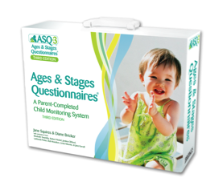
SCREENING TRAINING: Ages and Stages Questionnaire-3 (ASQ-3)
Notes:
ASQ materials are copyrighted. If you plan to train staff in the use of the ASQ-3 tool, your agency will need to purchase the materials for the measure.
Purchasing a site license, for example, will allow you to print out measures as needed for use in training staff.
*

Slide 9
ASQ-3: Overview
Standardized screening measure
Available in English, Spanish and other languages
Can be completed by parent in 10-15 minutes
For children from 2 to 60 months of age (different forms for different ages)
Accurately identifies children at risk for developmental delays
Encourages parent involvement
Parents learn about development while completing measure
Notes:
*

Slide 10
ASQ-3: Domains
Communication Language skills
Gross Motor: Coordination of arms and legs
Fine Motor Coordination of hands and fingers
Problem Solving Problem-solving skills and how to play with toys
Personal-Social Self-help skills and interactions with others
EARLY SCREENING, BETTER OUTCOMES:
Developmental Screening & Referral Toolkit for Family Serving Agencies

Slide 11
ASQ-3: Age Administration Chart
The first step is to select the correct ASQ-3 for the child’s age
Notes:
This slide assumes an agency is using the paper/printed version of the ASQ-3. If using the on-line version, the program will select the correct measure for the child’s age.
If using the paper/printed version, we recommend that you print a handout for participants with the “Age Administration Chart.” You could also put a screenshot of that table on this slide (It is copyrighted, so we did not include it here.) This will show the correct measure to use for each age group. You can then highlight the ages that you will be using for your screening initiative.
*

Slide 12
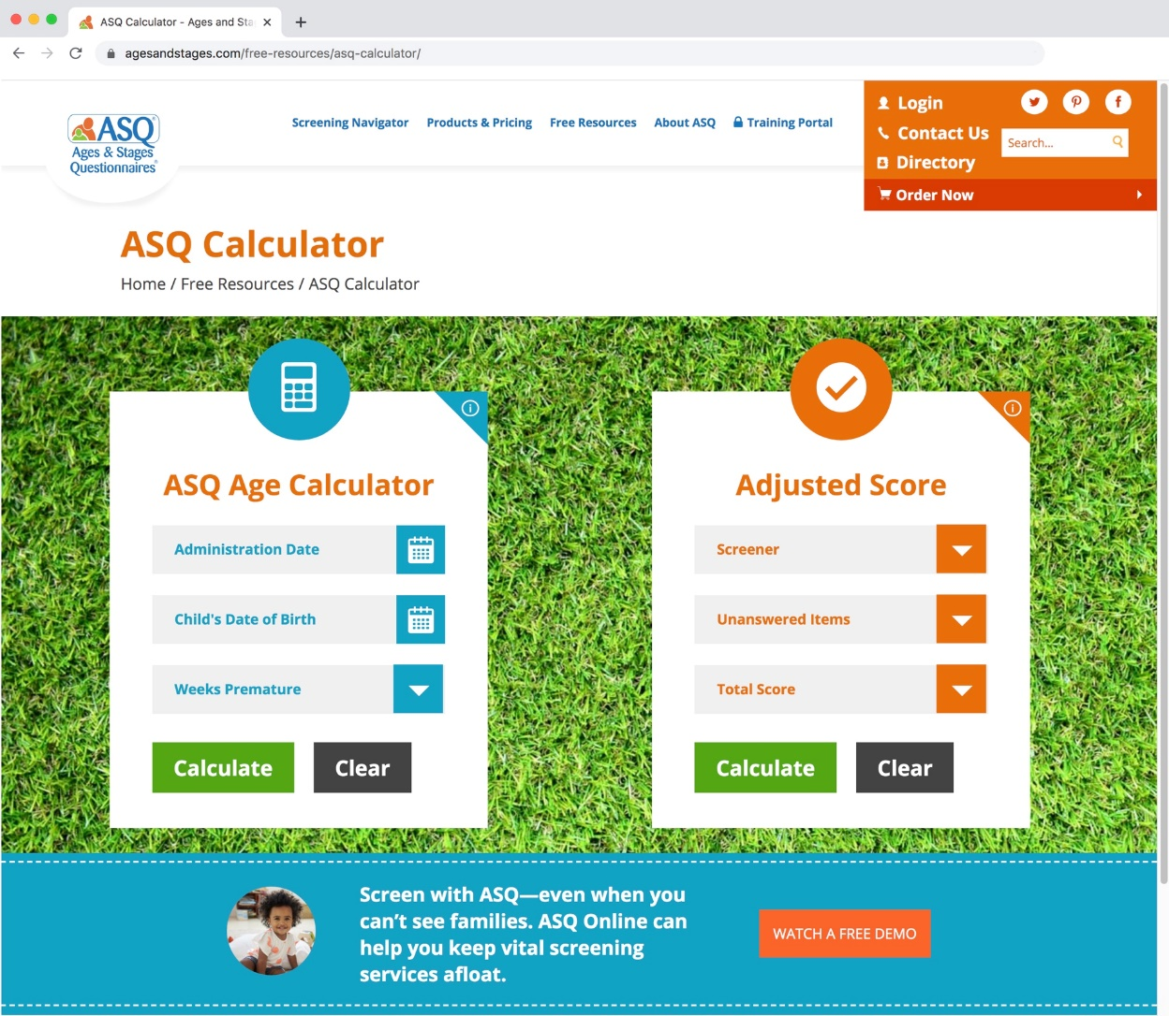
Online Age Calculator
http://agesandstages.com/age-calculator/
*
Notes:
There is an on-line calculator that allows you to quickly calculate the child’s age and identifies which measure to select.
We recommend going to the website and showing the participants how to use it, by entering an administration date, child’s date of birth, and if applicable, number of weeks premature.
*

Slide 13
ASQ-3: Adjustment for Prematurity
Children considered premature: those born before 37 weeks of gestational age.
Adjust the age for prematurity for children younger than 24 months of age.
Example: Alexandra is 18 months and two days old. According to the age chart, she would get the 18-month ASQ-3; however, she was born six weeks premature. So instead of giving the 18-month ASQ-3, she will get the 16-month ASQ.
Notes:
*

Slide 14
ASQ-3: Administration
Explain to the parent how to complete the questionnaire.
Parent will answer each question using “yes,” “sometimes,” or “not yet.”
Ask the parent to check “yes” or “no” for each question in the “Overall” section. If they check “yes” they should write an explanation.
Provide parent with assistance as well as the opportunity to complete ASQ-3 independently.
Notes:
Provide a handout to the audience that is a sample of the ASQ-3 measure. Choose a measure that matches one of the ages you’ll be using.
The ASQ-3 was written at 4th to 6th grade reading level to make it easier for parents to complete independently.
Staff should be available to answer questions if the parent has difficulty understanding a question.
The agency can also purchase an ASQ-3 Materials Kit. This bag of toys can be used by a parent with a child to determine if they are able to perform the skill.
*

Slide 15
ASQ-3: Scoring
Score each section of the questionnaire
Yes=10
Sometimes=5
Not yet=0
Notes:
The person who scores the ASQ-3 will vary by agency.
Once a person is familiar with the scoring, it takes about two minutes to score.
Use the sample questionnaire to show how to score it. For each item, write a number in the blank space to the right of the question. The numbers are shown above.

Slide 16
SAMPLE SCORING
Notes:
To practice, paste on this slide a screen shot of a completed section of an ASQ-3
Ask the audience to indicate what score to put in the blank space for each item.

Slide 17
ASQ-3: Scoring Steps
Write the score from each item in the blank to the right of each question.
Add the number of points and write in the total number for that specific domain:
Communication Total ___, Gross Motor Total___ etc.
In Section 1 of “ASQ-3 Information Summary” page:
Transfer the total score for each domain in the Total Score column.
Notes:
Direct the audience to look at the Information Summary page, which is the last page in their sample ASQ-3.

Slide 18
ASQ-3: Scoring Steps (cont’d)s
Fill in the circles with the corresponding score for each domain.
Transfer the Overall responses into Section 2 of the scoring sheet by circling “yes” or “no” (depending on the parent’s response to each question).

Slide 19
PRACTICE SCORING
Notes:
Provide a sample of an ASQ-3 that has the answers filled in (as if a parent completed it).
Fill in the correct score for the items in the first domain, the Total for that domain, and the bubbled number in the Information Summary for that domain, as an example.
Then, have the participants fill in the scores for the other domains, and the totals for each domain.
Have people check their answers by providing them with the correct Total Scores for each domain.
After they confirm they have the correct scores (and answer any questions for people who came up with a different score), have them fill in the bubbles on the Information Summary page.
You can also provide a completed Information Summary page for your example, so that they have the correct version to compare their answers to.

Slide 20
ASQ-3: Omitted Items
Try to obtain answers from parent; encourage them to make their “best guess.”
A maximum of two (2) items can be omitted. Steps to take when 1-2 items are omitted:
Calculate the average score for the answered questions in that domain (Divide the total score by the number of questions answered in that domain).
Add that number (the average score) to the total score to get a new Total Score for that domain.
Notes:
One complication occurs when a parent omits one or more items when they are completing the questionnaire.
If more than 2 items are omitted, then the questionnaire cannot be accurately scored.
If there are only 1 or 2 items missing and the parent cannot choose an answer, then follow the procedure for “omitted items.”
We’ll show an example on the next slide and you’ll get a chance to practice.
*

Slide 21
Sample: ASQ-3 Omitted Items
1. Divide total domain score by the number of items answered in that domain. Example: The domain has 6 items, and the parent only answered 5 of them. The total score for the 5 items that were answered is 45.
45 (area score) ÷ 5 (items) = 9 points
2. Add this average item score to the total domain score to get a new total score.
45 + 9 points = new total of 54 points
Notes:
This method helps us to make the “best guess” about what the score would have been if the parent had filled it in. The best guess is based upon the other scores in that area.
For example, if 5 items were answered with “5”, what would the best guess be for the 6th item? (answer: 5). Show how 5*5/5 =5.
Repeat with 5 items answered with “10”: best guess for the 6th item would be 10. Show how 10*5/5 = 10.
Participants should know that the need to omit items does not happen very often. Items should only be omitted if they are inappropriate to try with a child.
For example, the mirror items are inappropriate because of cultural and spiritual beliefs to some families.
However, if the only reason an item is omitted is lack of opportunity, the child should be given the opportunity to practice and try the item.

Slide 22
PRACTICE OMITTED ITEMS
Notes:
We recommend that you copy a section of the ASQ-3, where all but one answer is completed.
Have the participants try figuring out what the Total Score should be, using the omitted items calculation.
Provide them the correct response and answer any questions for people that had difficulty getting the correct answer.
Show on the Information Summary page how, if you did not give “credit” for that omitted item, a child’s score could appear very low in that domain.
Giving credit for the omitted item — by using the “best guess” of what it would have been —will produce a more accurate score.

Slide 23
ASQ-3: Interpretation
Black Area: Problem
Gray Area: May Have a Problem
White Area: No Problem
Note: Parental concerns may also signify a problem.
Notes:
The Information Summary shows three levels of concern (outlined above).
In addition to looking at the scores, the provider will be discussing any concerns that the parent brings up or any concerns noted in Section 2 of the Information Summary page.
The medical providers will be reviewing the results with the family and making recommendations and referrals if there is an area of concern.
Note: We don’t recommend using words like “pass” and “fail” when reviewing screening results.
*

Slide 24
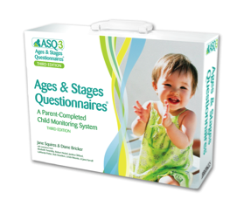
Ages and Stages Questionnaire:
Social-Emotional (ASQ:SE-2)

Slide 25
What is the ASQ:SE-2?
Questionnaire that identifies young children at risk for social or emotional difficulties
Designed for parents to complete
Research shows that if only the ASQ-3 is administered, many children who have social-emotional needs will be missed.
Notes:
When the same children were given both the ASQ-3 and the ASQ:SE-2, many children had concerns noted on the ASQ:SE-2 but their ASQ-3 did not show any areas of concern. Therefore, it is important to specifically screen for social-emotional needs.
Williams, M. E., Zamora, I., Akinsilo, O., Hickey Chen, A., & Poulsen, M. K. (2018). Broad developmental screening misses young children with social-emotional needs. Clinical Pediatrics, 57, 844-849.

Slide 26
ASQ:SE-2 Domains
Self-Regulation: Does your child settle herself down after exciting activities?
Compliance: Does your child do what you ask him to do?
Communication: Does your child look at you when you talk to her?
Adaptive Functioning: Does your child stay away from dangerous things such as fire and moving cars?
Autonomy: Does your child cling to you more than you expect?
Affect (mood): Does your child seem happy?
Interactions with People: Does your child try to hurt other children, adults or animals (for example, by kicking or biting)?
Notes:
There is only one total score for the ASQ:SE-2 (unlike the ASQ-3, which has separate scores for the different domains).
This slide shows the various areas that are covered in the ASQ:SE-2 questions. All questions are included in one total score.

Slide 27
ASQ:SE-2 Scoring
Response to each item can be:
“Often or always”
“Somewhat”
“Rarely or Never”
In addition, parents are asked to check items that they are concerned about.

Slide 28
ASQ:SE-2 Scoring
Each response option has a letter (z, v, or x) next to it that indicates what numerical score to give that response.:
z = 0 points
v = 5 points
x = 10 points
If the parent also checked the “concern” box, add 5 additional points.
Write the total number of points in the blank to the right of the question for each item.
Notes:
Note the placement of the responses receiving 0, 5 or 10 points varies depending on the question.
For some questions, the first answer choice gets a score of “0,” and for others, the right-hand answer choice gets a score of “0.”
Be sure to look at the small letters to determine what items scored a five.

Slide 29
PRACTICE SCORING ASQ:SE-2
Notes:
We recommend putting a screen shot of a section of the ASQ:SE-2, showing a few sample answers, with responses filled in.
Demonstrate that sometimes the “z” is the left hand answer, while other times, the “z” is the right hand answer.
Go through the correct score for each item on the screen.
NOTE: We did not include the screenshot here because it is copyrighted, but if you purchased a site copy of the measure, you can provide it to your audience.

Slide 30
ASQ:SE-2 Summary Sheet
Transfer “Total Points” on each page to the summary sheet.
Add up all Total Points in section 1 for the “Total Score”
Transfer Total Score to the box next to the cutoff score.
If the Total Score is higher than the cutoff, then there is a concern, and a referral should be made.
Section 3: Circle “yes” or “no” for each question.

Slide 31
ASQ:SE-2 SUMMARY SHEET SAMPLE
Notes:
We recommend putting a screen shot of an ASQ:SE-2 summary sheet, showing a score that is over the cutoff.
Note that for the ASQ:SE-2, a higher score means a problem. In contrast, for the ASQ-3, a lower score means a problem.

Slide 32
ASQ:SE-2: Scoring Omitted Items
Check for missing items and ask parents to try to answer.
If 1-2 items are missing: go ahead and score the usual way.
If 3 or more items are missing: determine if the total score is within 5 points of the cutoff.
If no: do not adjust score.
If yes: score must be adjusted (see next slide).

Slide 33
ASQ:SE-2: Adjusting the Score
Divide the total score by the number of items parents answered. That gives you the average score per item.
Use that average score for each missing item. For example:
Parent omitted 3 items (answered 30 out of 33 questions)
Total score = 80
Divide 80 by 30 = 2.66 (the average score)
Add 2.66 to each unanswered question: 3 (no. of missing items) x 2.66 points = 7.98 (Can round up to 8)
Add to total score: 80 + 8 = 88
Notes:
Note: The process for adjusting for omitted items is similar to what was done on the ASQ-3.

Slide 34
Miguel’s Results…
Please score the ASQ-3 and ASQ:SE-2 screening measures and determine if there are any areas of concern based on the results.
Please debrief with your partner and as a group.
Notes:
In our trainings, we created a sample of an ASQ-3 and an ASQ:SE-2 for Miguel, age 10 months, the child who was introduced in the first slide.
Fill in the items as if the parent completed them.
The audience then scores each item and completes the Summary pages for each measure. This is helpful as extra practice.
Some groups enjoy timing themselves to see how quickly they can score the ASQ. This helps illustrate that it is not a time-consuming activity.
*

Slide 35
ASQs: Frequently Asked Questions
Q: Isn’t the staff member’s impression of the child’s development more accurate than that of the parents?
A: The ASQ is designed to be completed by a parent who knows the child well. This information is then combined with the staff member’s expertise to determine the best approach for any concerns that arise.
Q: What if the provider does not see the problems that the parent is reporting on the questionnaire?
A: Defer to the parent because they have the opportunity to observe the child in many different settings.
Q: Can the questionnaire be completed by a babysitter/other family member?
A: The ASQ:SE-2 can be completed by anyone who has 20 or more contact hours per week with a child.
Q: I’ve noticed when the ASQ:SE-2 is completed by two different caregivers, the scores come out different. How do we know which one is right?
A: Scores may differ since a child's behavior will often be different in different settings and with different caregivers. There are no right and wrong answers.

Slide 36
M-CHAT-R: Modified Checklist for Autism in Toddlers (Revised)

Slide 37
Disparities in Screening for ASD?
Referral, diagnosis and treatment may be late or reduced for:
Children of color, particularly Latino and Black children
Children with less severe symptoms and delays
Children from lower socioeconomic backgrounds
Consistent screening helps reduce disparities and ensures children get connected with early intervention.

Slide 38
M-CHAT-R: Overview
Parent-report screening tool
Standardized questionnaire
Validated for children between 16-30 months
20 items with Yes/No responses
Translated into multiple languages and used in many countries
Available for free at www.mchatscreen.com
Notes:
The paper that provided validation for the tool is:
Robins, D. L., Casagrande, K., Barton, M., Chen, C. A., Dumont-Mathieu, T., & Fein, D. (2013). Validation of the Modified Checklist for Autism in Toddlers, Revised with Follow-up (M-CHAT-R/F). Pediatrics, peds.2013-1813; DOI: https://doi.org/10.1542/peds.2013-1813.

Slide 39
M-CHAT-R: Overview
MCHAT-R Items as Predictors of ASD
Best discriminators of ASD:
Points to show interest
Responds to name
Shows interest in other children
Brings objects to show
Follows point
Imitates actions
Responds to smile
Notes:
Weitlauf, A. S., Vehorn, A. C., Stone, W. L., Fein, D., & Warren, Z. E. (2015). Using the M-CHAT-R/F to Identify Developmental Concerns in a High-Risk 18-Month-Old Sibling Sample. Journal of developmental and behavioral pediatrics : JDBP, 36(7), 497–502. doi:10.1097/DBP.0000000000000194

Slide 40
M-CHAT-R: Scoring
If you point at something across the room, does your child look at it? (FOR EXAMPLE, if you point at a toy or an animal, does your child look at the toy or animal?)
Yes (0) No (1)
Does your child play pretend or make-believe? (FOR EXAMPLE, pretend to drink from an empty cup, pretend to talk on a phone, or pretend to feed a doll or stuffed animal?)
Yes (0) No (1)
Notes:
Pass out sample of the questionnaire.
For each item (except the three on the next slide), an answer of “no” is scored with 1 point.

Slide 41
Reverse Scoring (For Items 2, 5, and 12: “YES” indicates ASD Risk)
2. Have you ever wondered if your child might be deaf?
YES (1) NO (0)
5. Does your child make unusual finger movements near his or her eyes? (FOR EXAMPLE, does your child wiggle his or her fingers close to his or her eyes?)
YES (1) NO (0)
12. Does your child get upset by everyday noises? (FOR EXAMPLE, does your child scream or cry in response to noise, such as a vacuum cleaner or loud music?)
YES (1) NO (0)
Remember that, except for the reverse scoring questions:
Yes (0) No (1)

Slide 42
M-CHAT-R Interpretation and Follow-up Recommendations
HIGH-RISK: Total score is 8-20 (Problem)
Refer for diagnostic evaluation and eligibility evaluation for early intervention.
MEDIUM-RISK: Total score is 3-7 (Possible problem)
Administer the follow-up interview (second stage of M-CHAT-R/F) to get additional information about at-risk responses.
LOW-RISK: Total score is 0-2 (No problem)
If child is younger than 24 months, screen again after second birthday.

Slide 43
M-CHAT-R Follow-up Questions
If the total score is 3-7, the staff member should use the guide for follow-up questions to get more information that will help decide if the child is at high risk and if they should be referred for additional evaluation.
Notes:
If applicable, pass out the follow-up interview guide for the M-CHAT-R, and practice going through the decision tree. This will be dependent on who is scoring, interpreting, and/or providing referrals.

Slide 44
M-CHAT-R Case Exercise
Please score the sample M-CHAT-R and review the results as a group.
Notes:
Complete a sample M-CHAT-R. Be sure to score a “high risk” response for one of the reverse items, so the audience will have practice catching the reverse scored items.
Have each participant score the measure and then share the correct score.
Discuss any questions to ensure everyone understands how to score.

Slide 45
THANK YOU!

